Slide 1
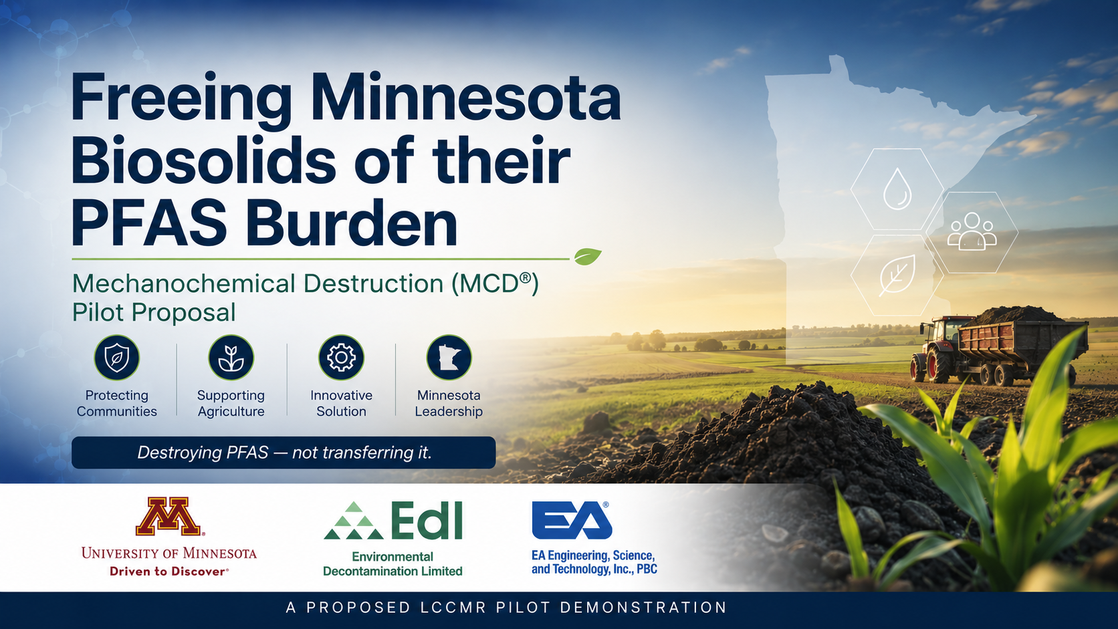

Slide 2
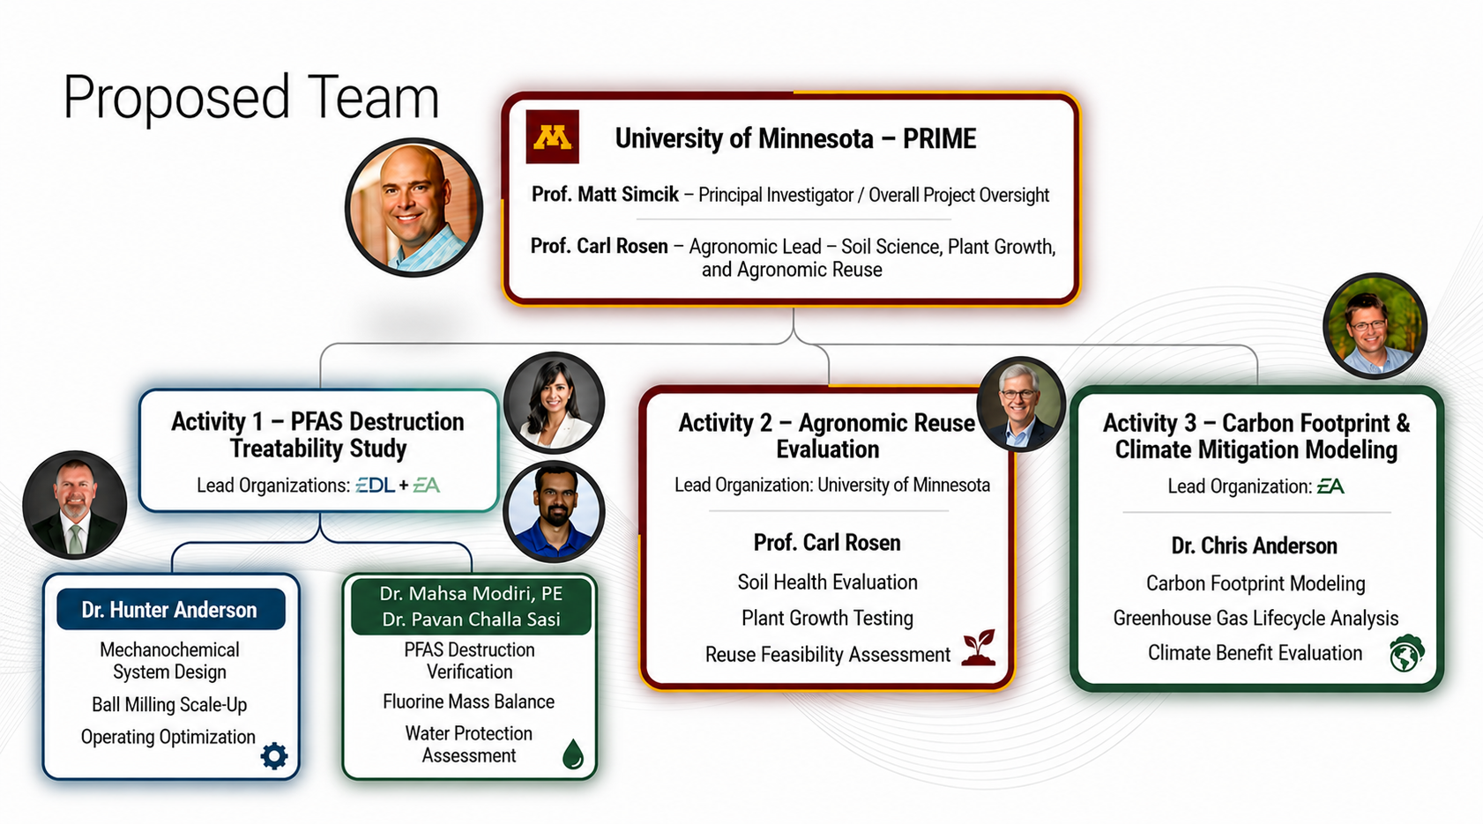
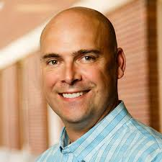
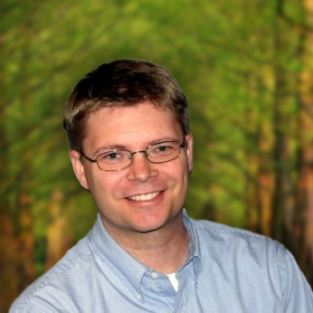

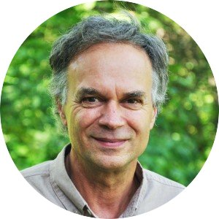
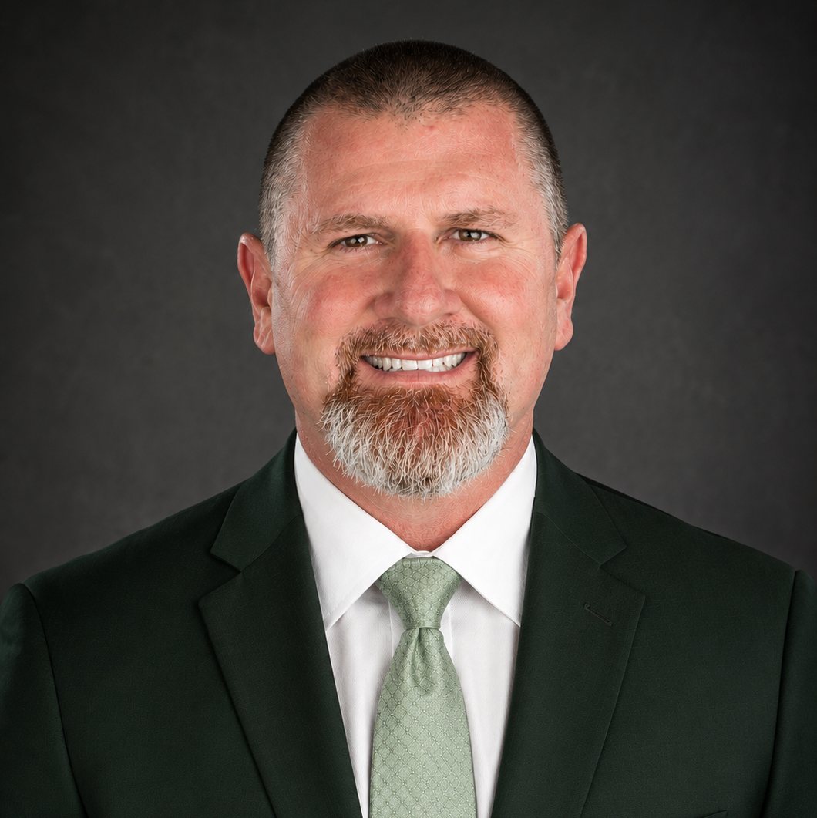
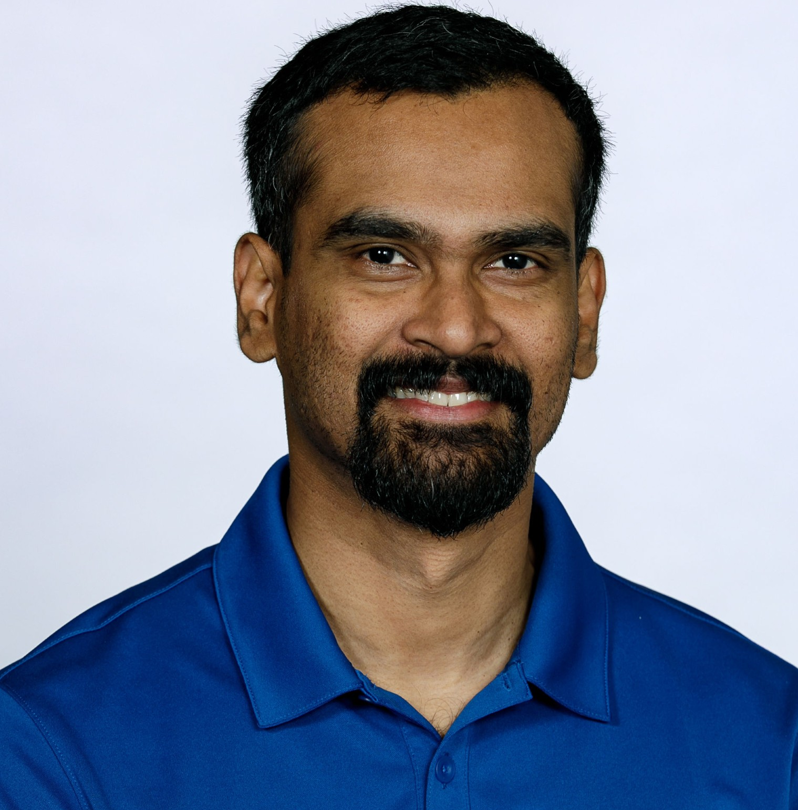

Proposed Team
Proposed Team

Slide 3


Slide 4
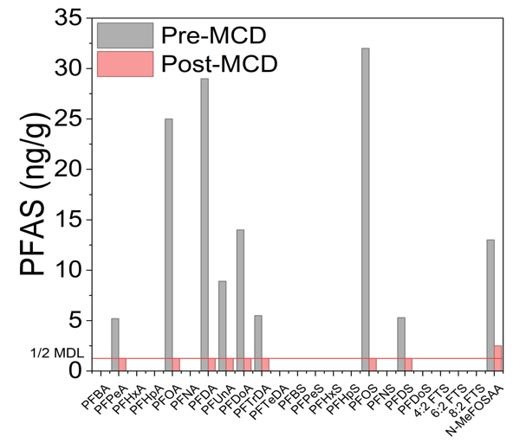
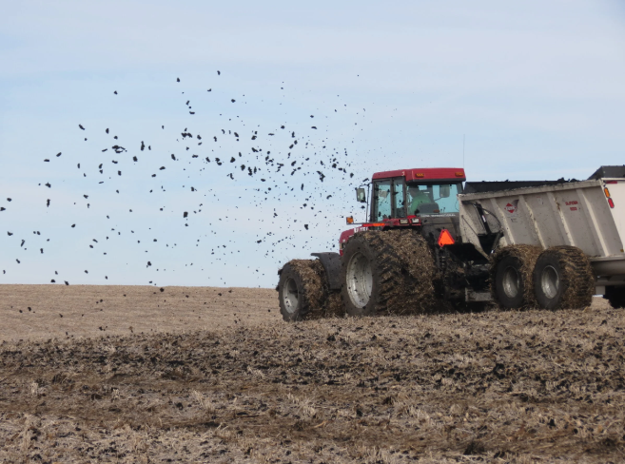
Successful and Ongoing Pilots
Soil and sediment Ongoing projects
Spent sorbents (e.g., GAC) Pursuing funding
Concrete and asphalt Pursuing funding
Industrial sludges/residuals Pursuing funding
Biosolids LCCMR Proposal
Unoptimized Benchtop Trial
Agronomic Reuse
?

Slide 5
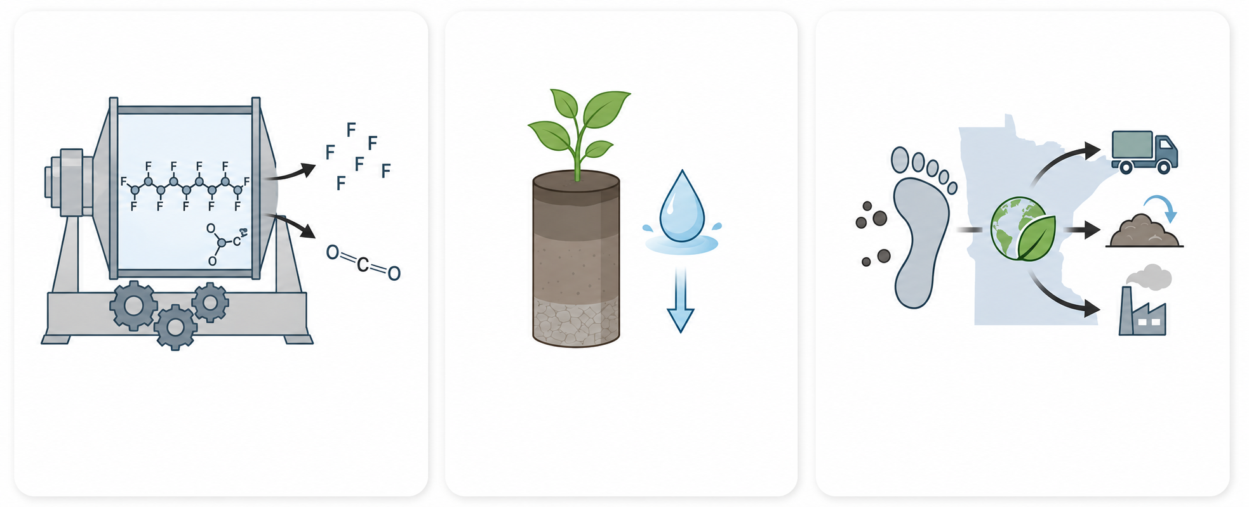
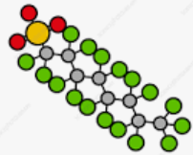
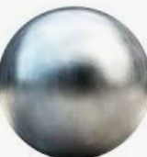

Proposed Activities for Pilot Study
Activity 1
Activity 2
Activity 3
Identify optimum run parameters
Validate destruction efficiency for all PFAS including short-chains and ultra short-chains (TFA)
Assess leachate for PFAS
Confirm yield benefits
Identify changes (if any) to the nutrient speciation
Determine carbon footprint of a full-scale MCD plant and compare with status quo scenarios
Goal: demonstrate complete destruction and beneficial reuse!

Slide 6
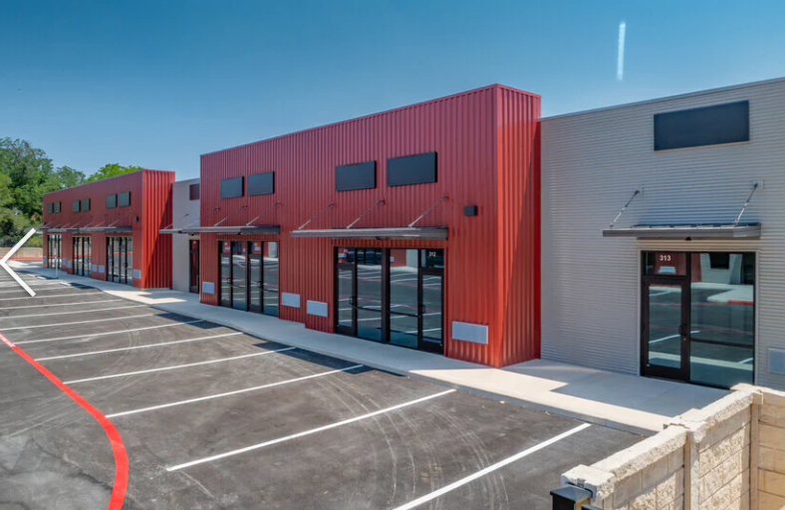
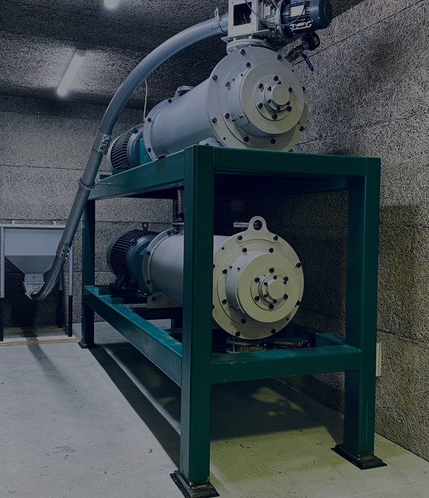
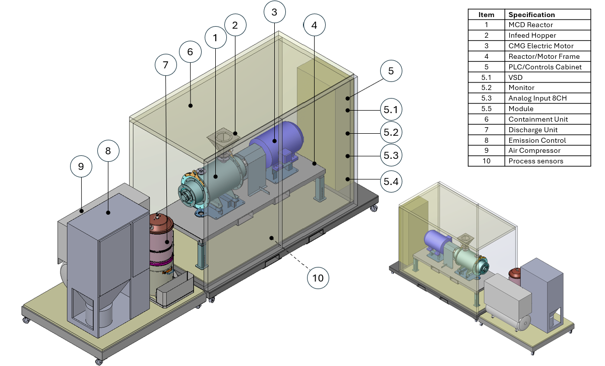
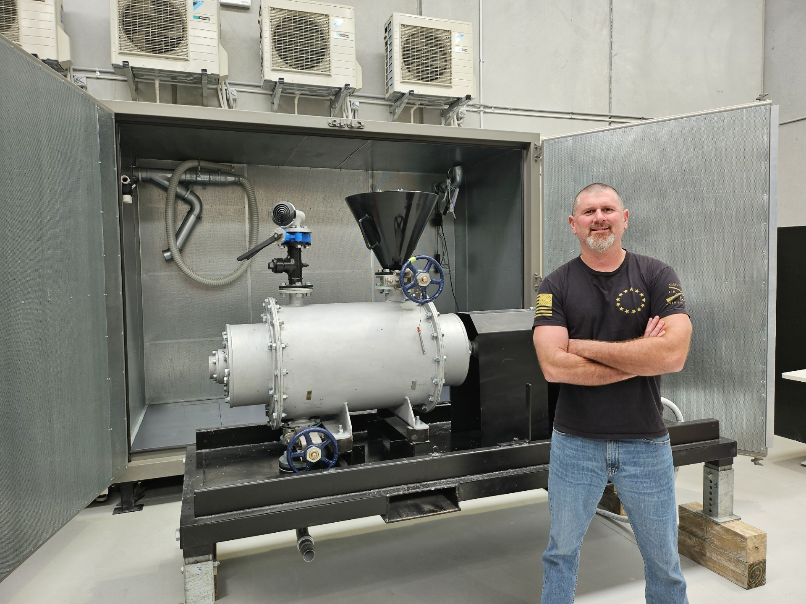
Treatability Lab: MCD Technology
US Operations
(~300 L)
Dr. Hunter Anderson: Edl Chief Strategy Officer
Operational Summer 2026

Slide 7
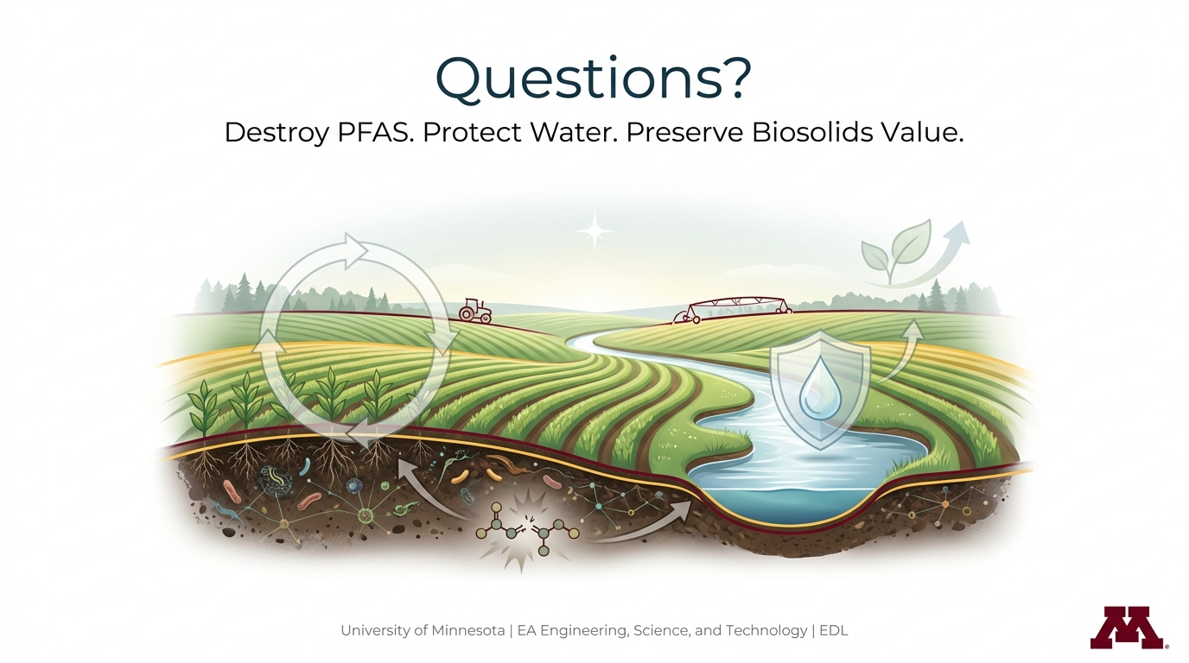
Dr. Matt Simcik
msimcik@umn.edu

Slide 8
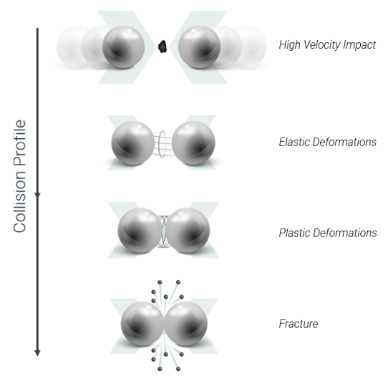


The Science
Thousands of ball bearings collide within Edl’s proprietary ball mill at incredibly high velocities
  Immense mechanical forces promote chemical reactions via multiple mechanisms
  Crystalline mineral phases fracture at the points of impact creating reactive surfaces
Rapidly expanding field of environmental science
  PFAS is Edl’s primary research focus

Slide 9
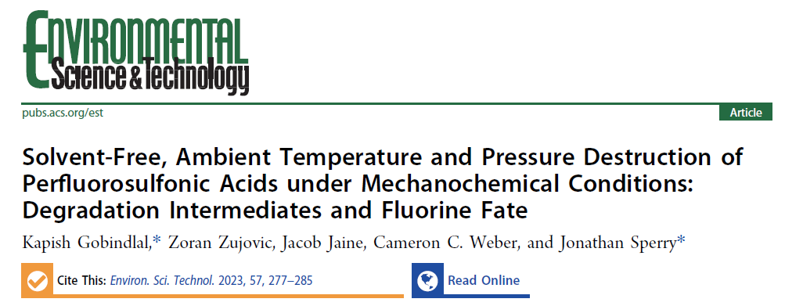
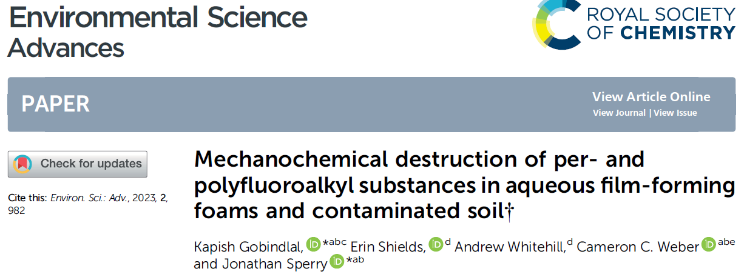
Edl’s 20-Year Portfolio
Edl’s PFAS work to date
  Currently at pilot-scale testing
  Pioneering the science
Soil remediation
  Legacy organics and asbestos
Waste recycling
  Mussel shells
  Pozzolan
  Electronics
  Tires
Nuclear waste
Liquid-to-solid transformation
Illicit drug seizures
Carbonate powder
Portland cement
Rare earth elements
Valorization

Slide 10
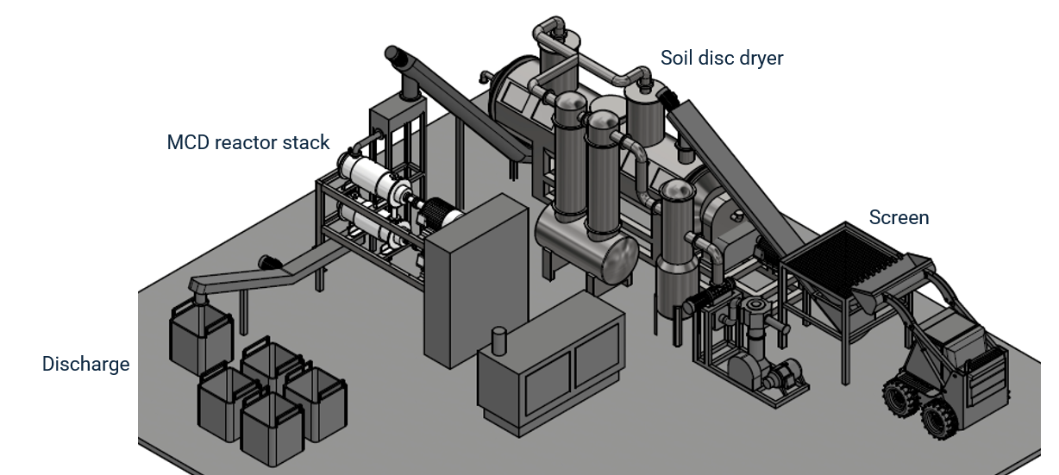
Technology Demonstration
Patented high-speed ball mill reactor (~300 L)
  MCD® reactors are stacked vertically in series to achieve desired destruction
Custom Commercial Plants (TRL = 9)

Slide 11
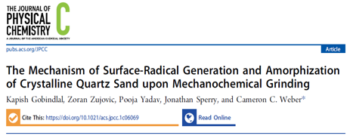
Proposed LCCMR Biosolids Pilot Study
Goal: Determine optimum parameterization that 1) maximizes PFAS destruction removal efficiency (DRE) and sustainable agronomic reuse potential and 2) mitigates combustion risk
Relevant parameters
  MCD run time
    PFAS destruction
    Matrix composition
  Sand dose
    Mitigates combustion
    Adds reactivity (SiO₂)
    Provides texture for reuse

Slide 12
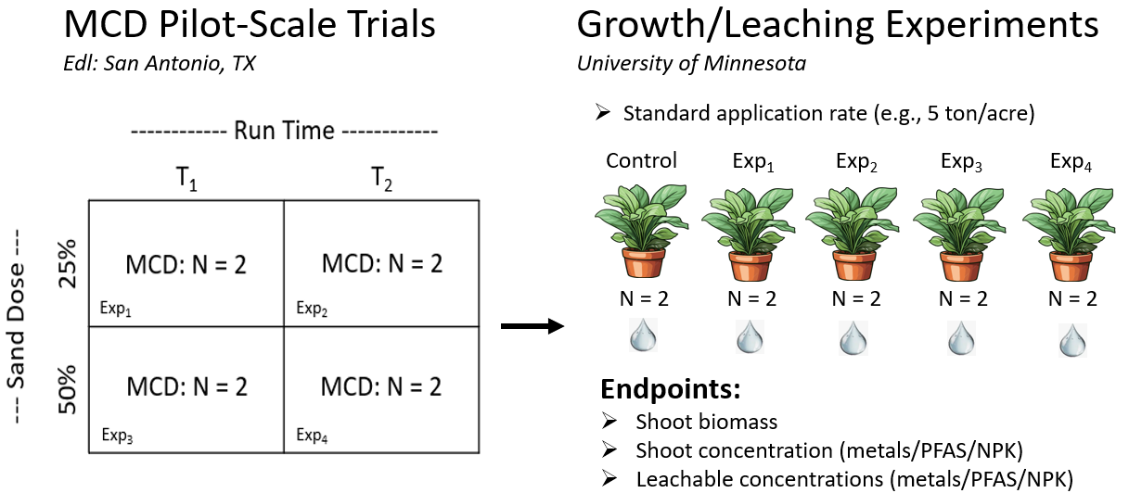
Proposed LCCMR Biosolids Pilot Study
Experimental approach

Slide 13
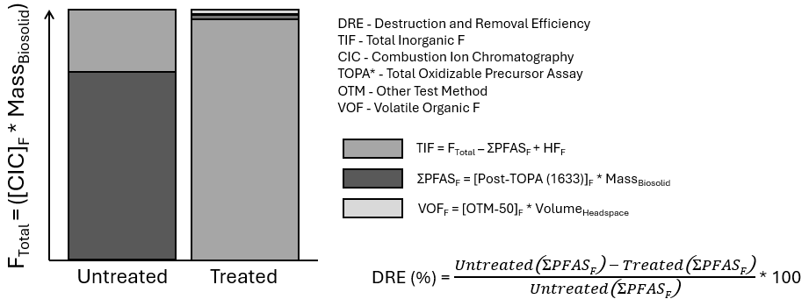

Proposed LCCMR Biosolids Pilot Study
Conduct fluorine mass balance

