Slide 1
State-Wide Reconnaissance of SARS-CoV-2 in Drinking Water Supplies
Drs. Timothy M. LaPara and
Raymond M. Hozalski
University of Minnesota

Slide 2
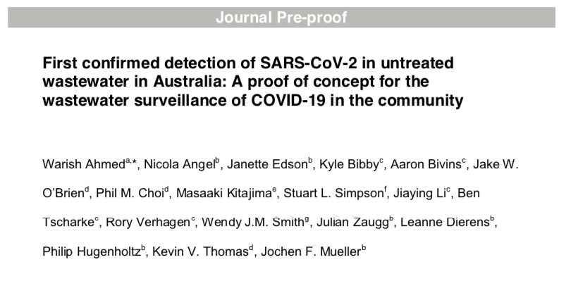
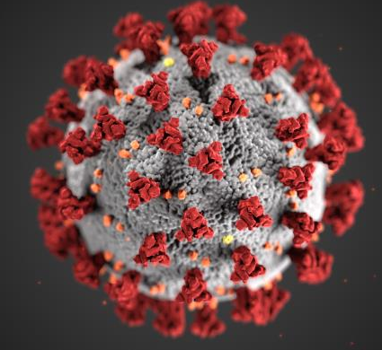
SARS-CoV-2 is known to be present in fecal material and has been quantified in raw sewage

Slide 3
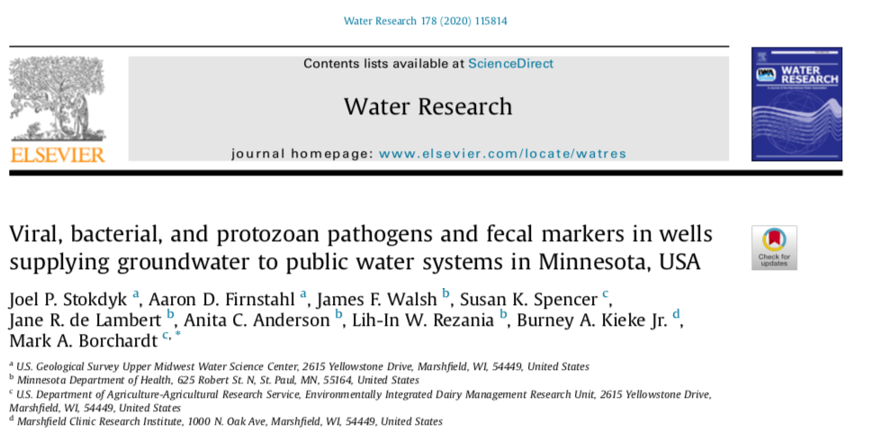
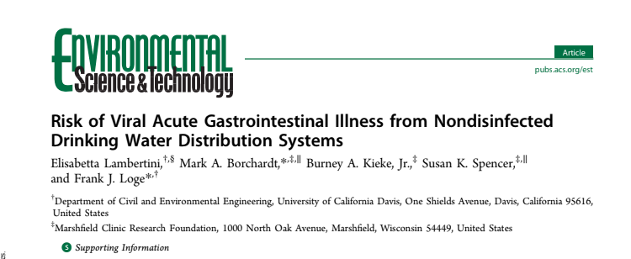
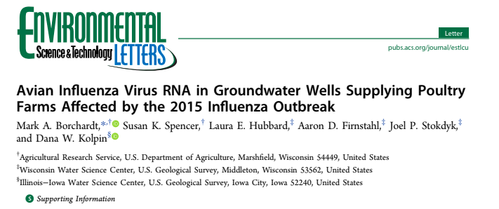
Other viruses are well-known to contaminate groundwater (from septic systems, leaking sewers, etc) and are capable of leading to illness

Slide 4
Proposed Work
Develop/optimize a method to quantify SARS-CoV-2 using commercially available supplies
Collect microbes from high-volumes of raw and treated drinking water from throughout the State of Minnesota, including:
Surface water systems (like Minneapolis or St. Paul; treated water expected to be negative)
Disinfected groundwater systems (like Eagan or Blaine; treated water expected to be negative)
Non-disinfected public and private groundwater systems (susceptible to contamination; primary concern)

