Slide 1
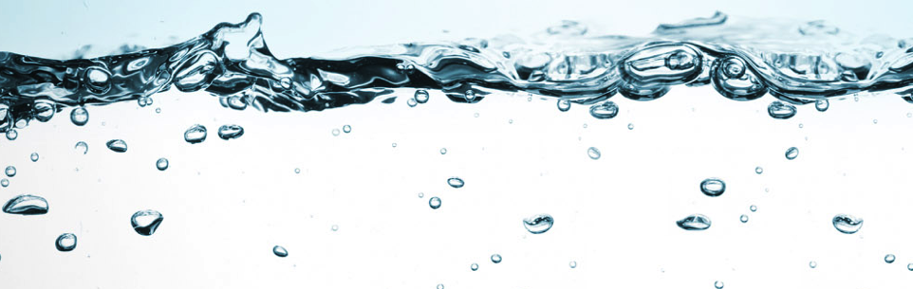
Flushing to Address Legionella Concerns Resulting from Extended Building Shutdowns
Drs. Raymond M. Hozalski and
Timothy M. LaPara
University of Minnesota

Slide 2
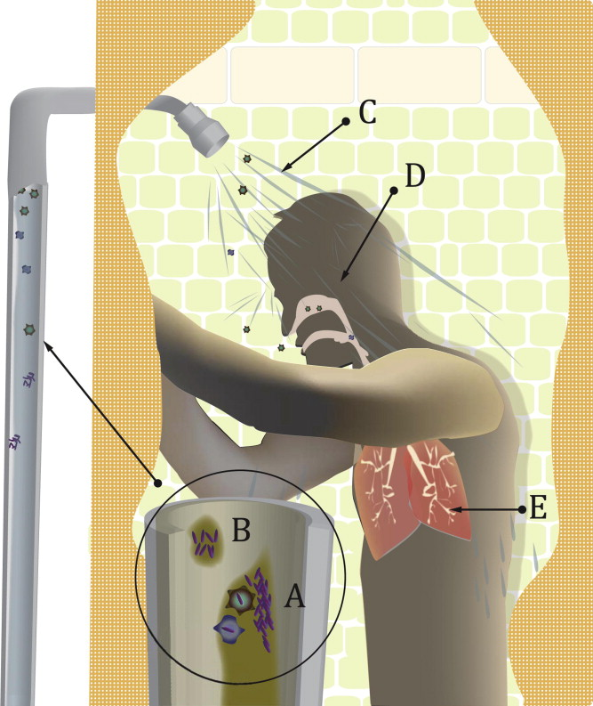
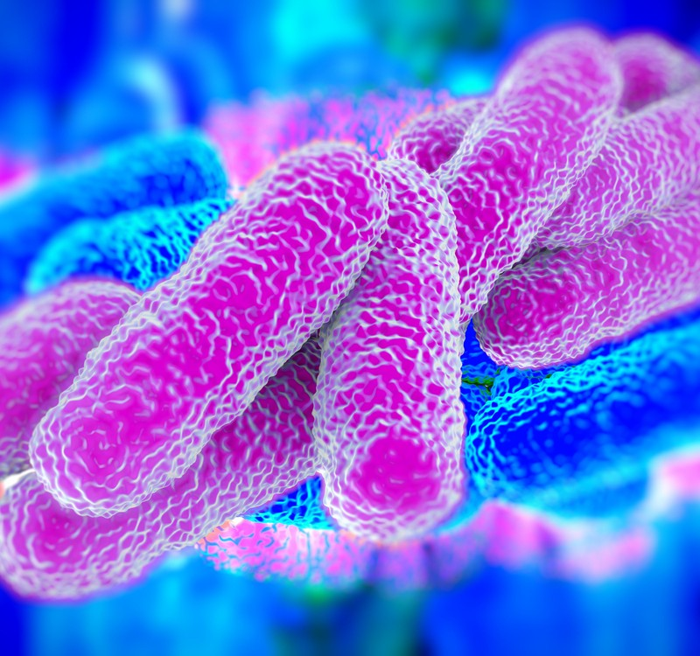
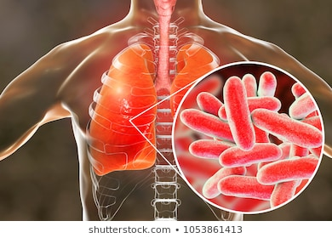
Legionella and Legionnaire's Disease
www.pacificwater.com.au
Source: Schoen and Ashbolt (2011)
Minneapolis VA taking steps to clean water system of Legionnaires disease bacteria Star Tribune, Nov 27, 2015

Slide 3
Need for the project
Legionella are a serious and growing public health concern but can be controlled with residual chlorine, which is intentionally put in the water by public utilities to prevent this and other problems
Extended building closures due to the COVID-19 pandemic results in water stagnation in building plumbing systems
When water stagnates, the residual chlorine dissipates, potentially allowing Legionella to grow

Slide 4
Research Questions
How bad is the problem?
Quantify opportunistic pathogens in stagnant water
How should we flush to improve water quality?
Effects of time (or volume) and temperature

Slide 5
Project Team and Partners
Ray Hozalski and Tim LaPara have worked together for ~20 years
U. Minnesota Facilities Management
Contact: Anita Anderson

