Slide 1
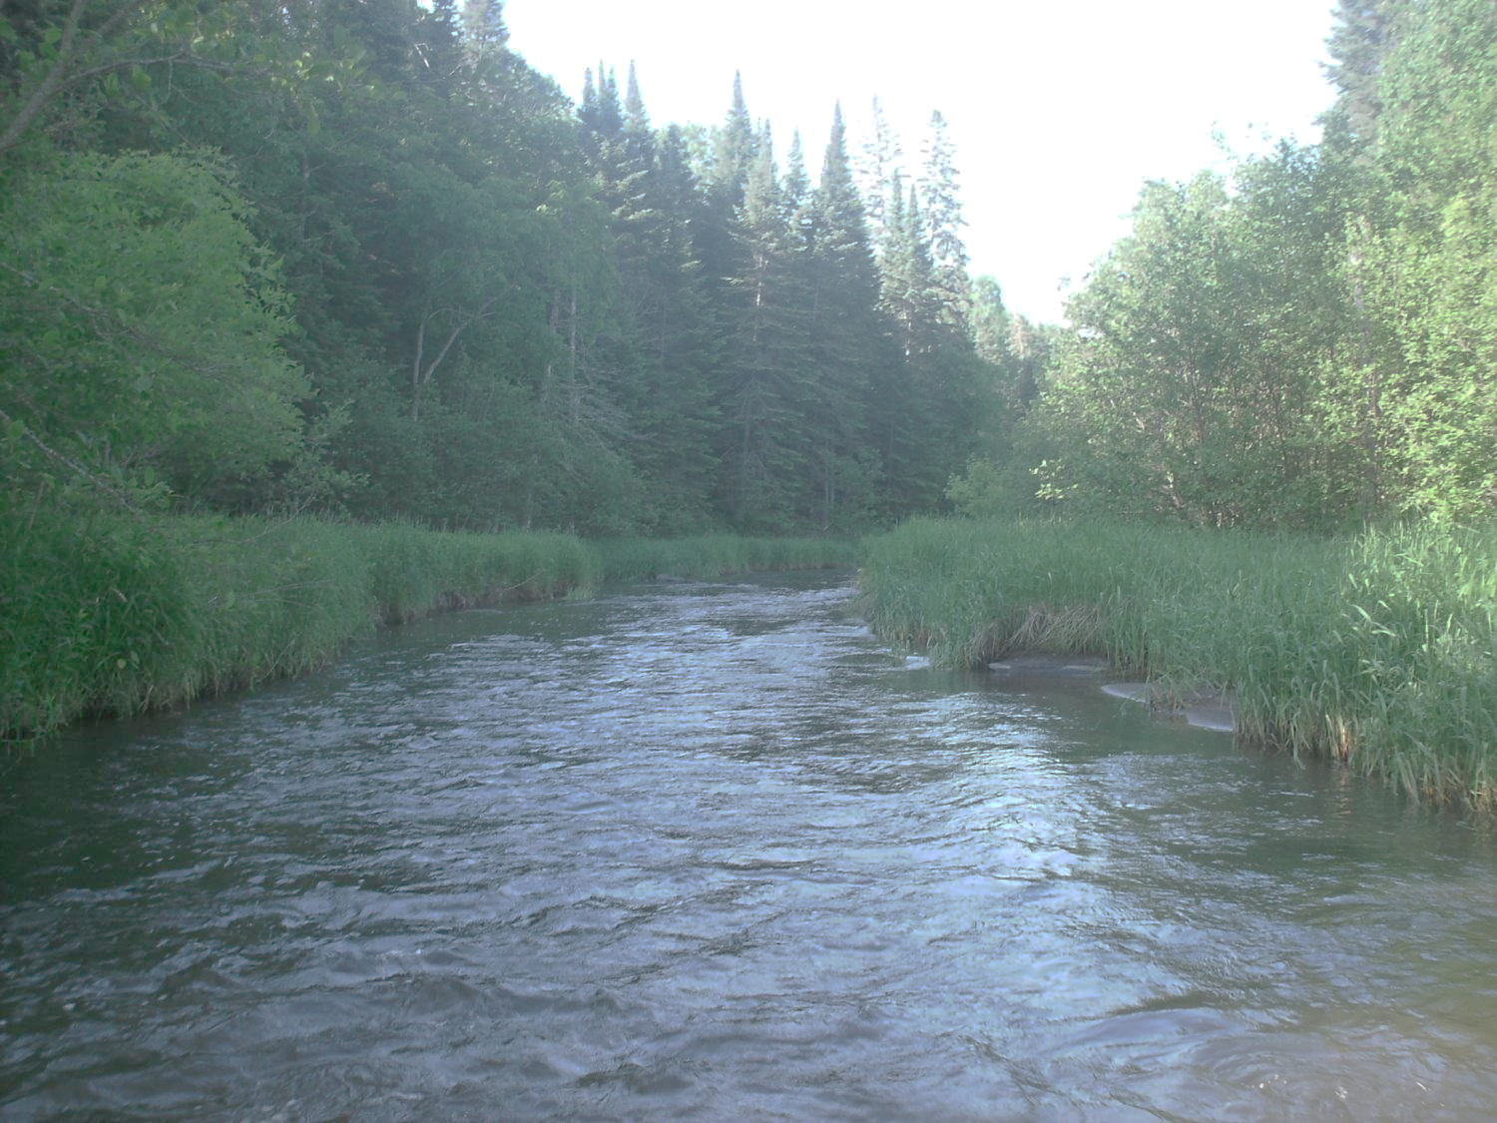
LCCMR Briefing
Legislative Water Commission
November 13, 2018
Jim Stark, Director
Straight River, Becker County
1

Slide 2
12 Elected Members
Body | First Name | Last Name | Party | District | Home
Sen | Paul | Anderson | R | 44 | Plymouth
Rep | David | Bly | DFL | 20B | Northfield
Sen | Rich | Draheim | R |  | Madison Lake
Sen | Kent | Eken | DFL | 4 | Twin Valley
Rep | Peter | Fischer | DFL | 43A | Maplewood
Rep | Glenn | Gruenhagen | R | 18B | Glencoe
Sen | Jason | Isaacson | DFL | 19A | Shoreview
Rep | Clark | Johnson | DFL | 19A | N. Mankato
Rep | John | Poston | R | 9A | Lake Shore
Rep | Paul | Torkelson* | R | 16B | Hanska
Sen | Bill | Weber | R | 22 | Luverne
Sen | Chuck | Wiger* | DFL | 43 | Maplewood

Slide 3
Statutory Powers and Duties
REVIEW agency water policy reports & recommendations
GATHER data and comments
MAKE RECOMMENDATIONS to assist the legislature in formulating legislation
SHARE data & information with LCCMR, CWC, legislative standing committees, upon request
COORDINATE

Slide 4

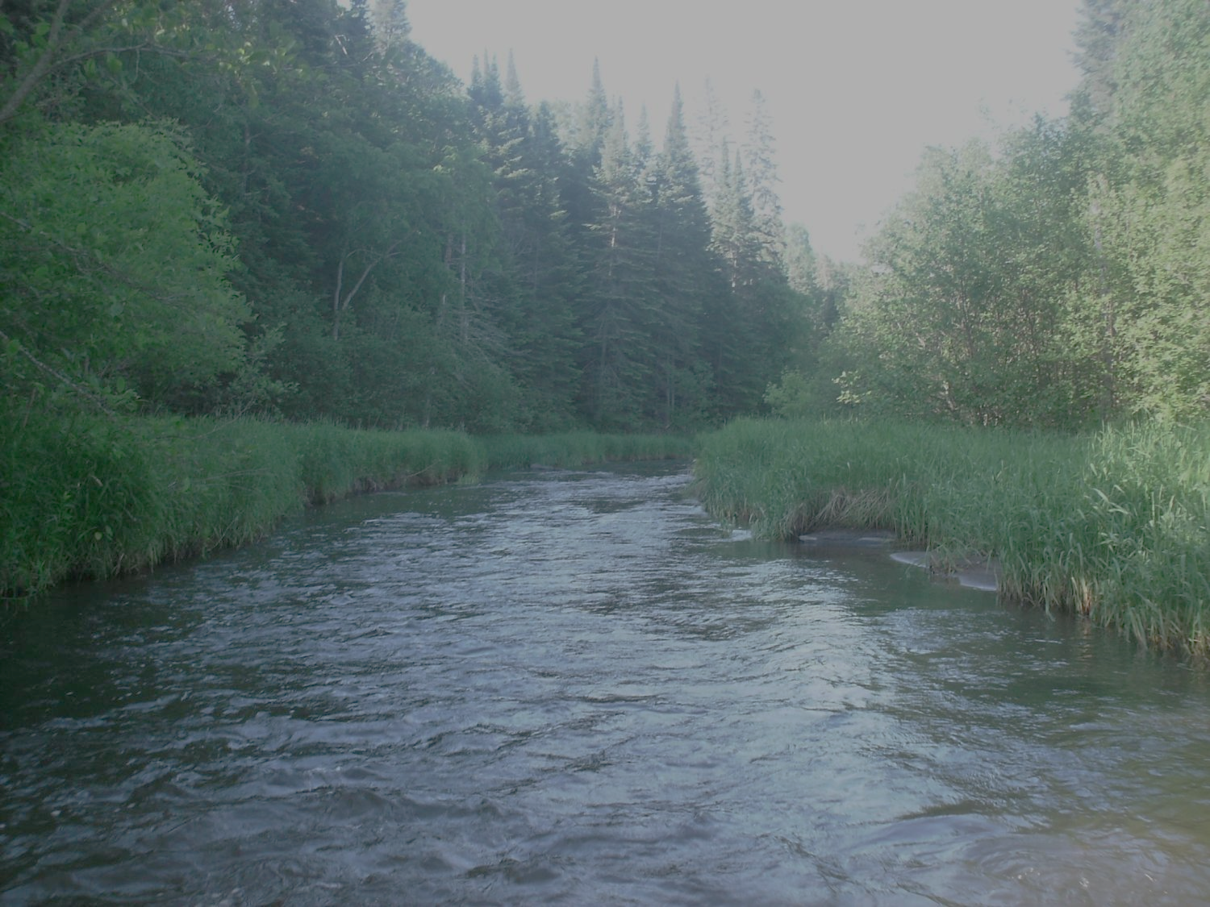

Agenda
Approval of minutes– October
Monthly Update-Jim Stark
Recommendation Summary
Member Discussion of Recommendations
Break
Briefing, Steve Riedel, Minnesota Trade Office (DEED)
* Member Consensus of Recommendations
* Next Steps in Recommendation Process
Future meetings
Adjourn
4

Slide 5
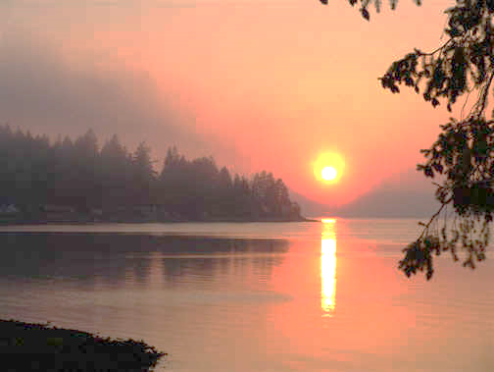
12 Recommendations
  Inflow and Infiltration-- Wastewater
  Healthy Soil/Healthy Water
  Water Infrastructure
  Peer review of wastewater standards
  Reducing excess Chloride
  Continuation of the LWC
  Keeping Water on the Land
  Data, information, Education and Public Awareness
  Preserving and protecting our lakes
  Expanded source water programs
  Increase drinking water protection Fee
  Statewide Water Policy
Notes:
For more information and real time monitoring data you can visit this web site.

Slide 6
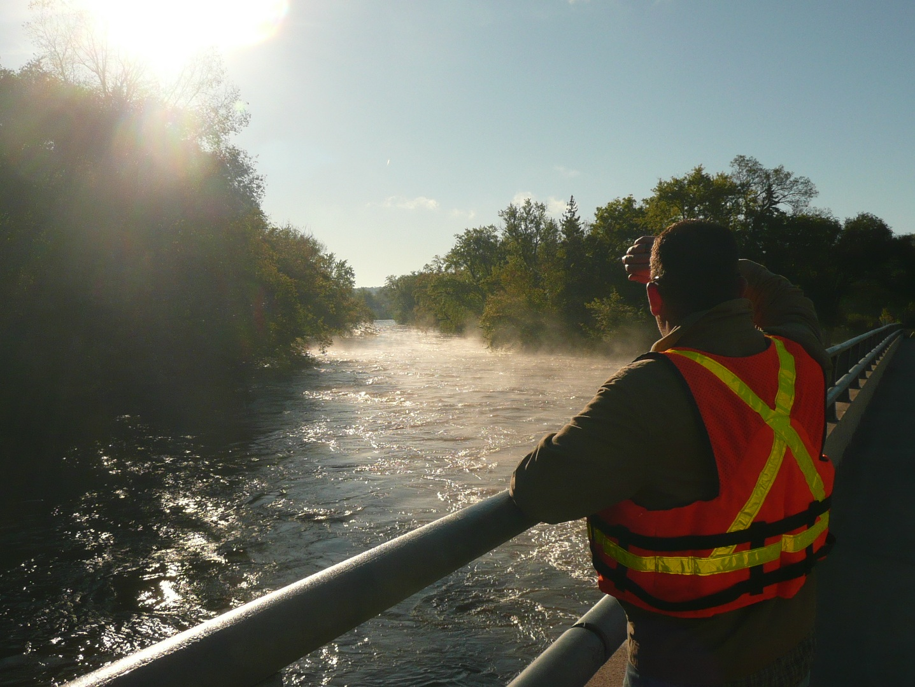
Pathway to Recommendations
6

Slide 7
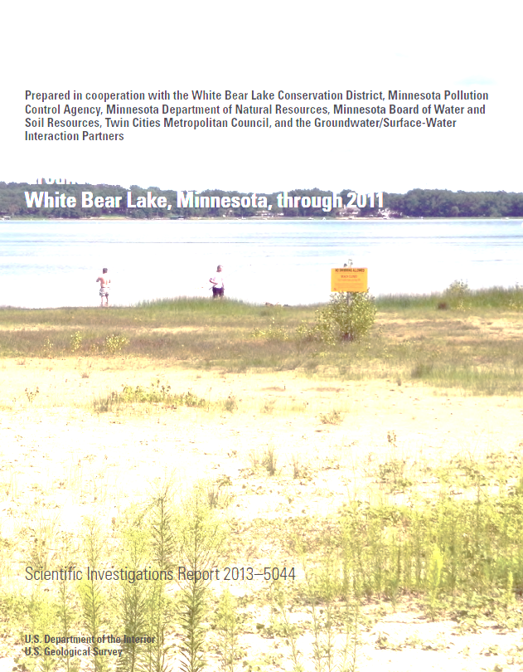
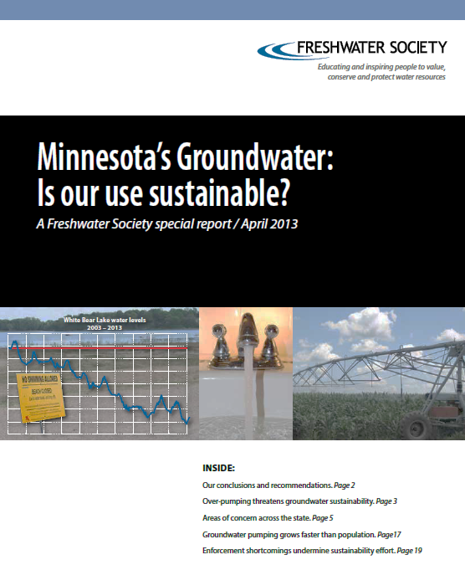
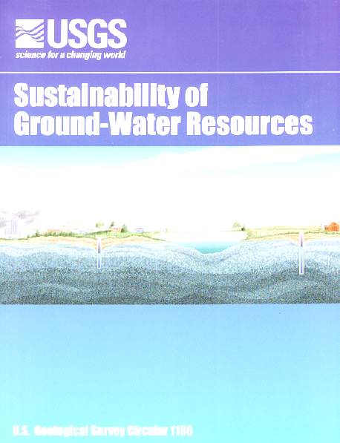
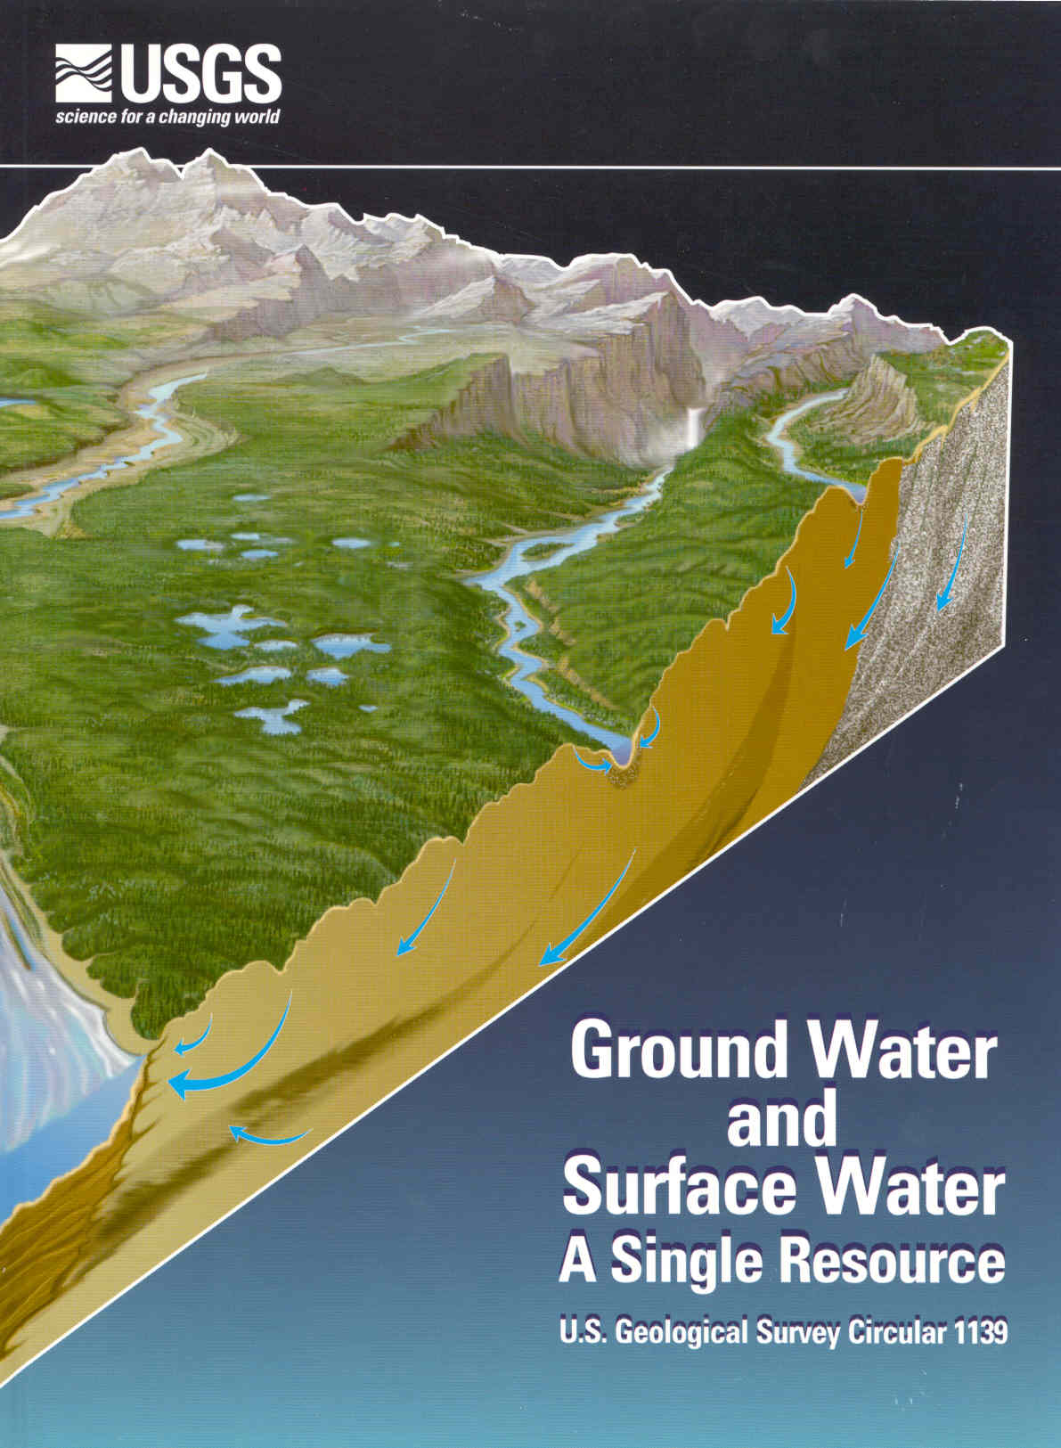
Step 1: Review of
reports and existing
recommendations

Slide 8
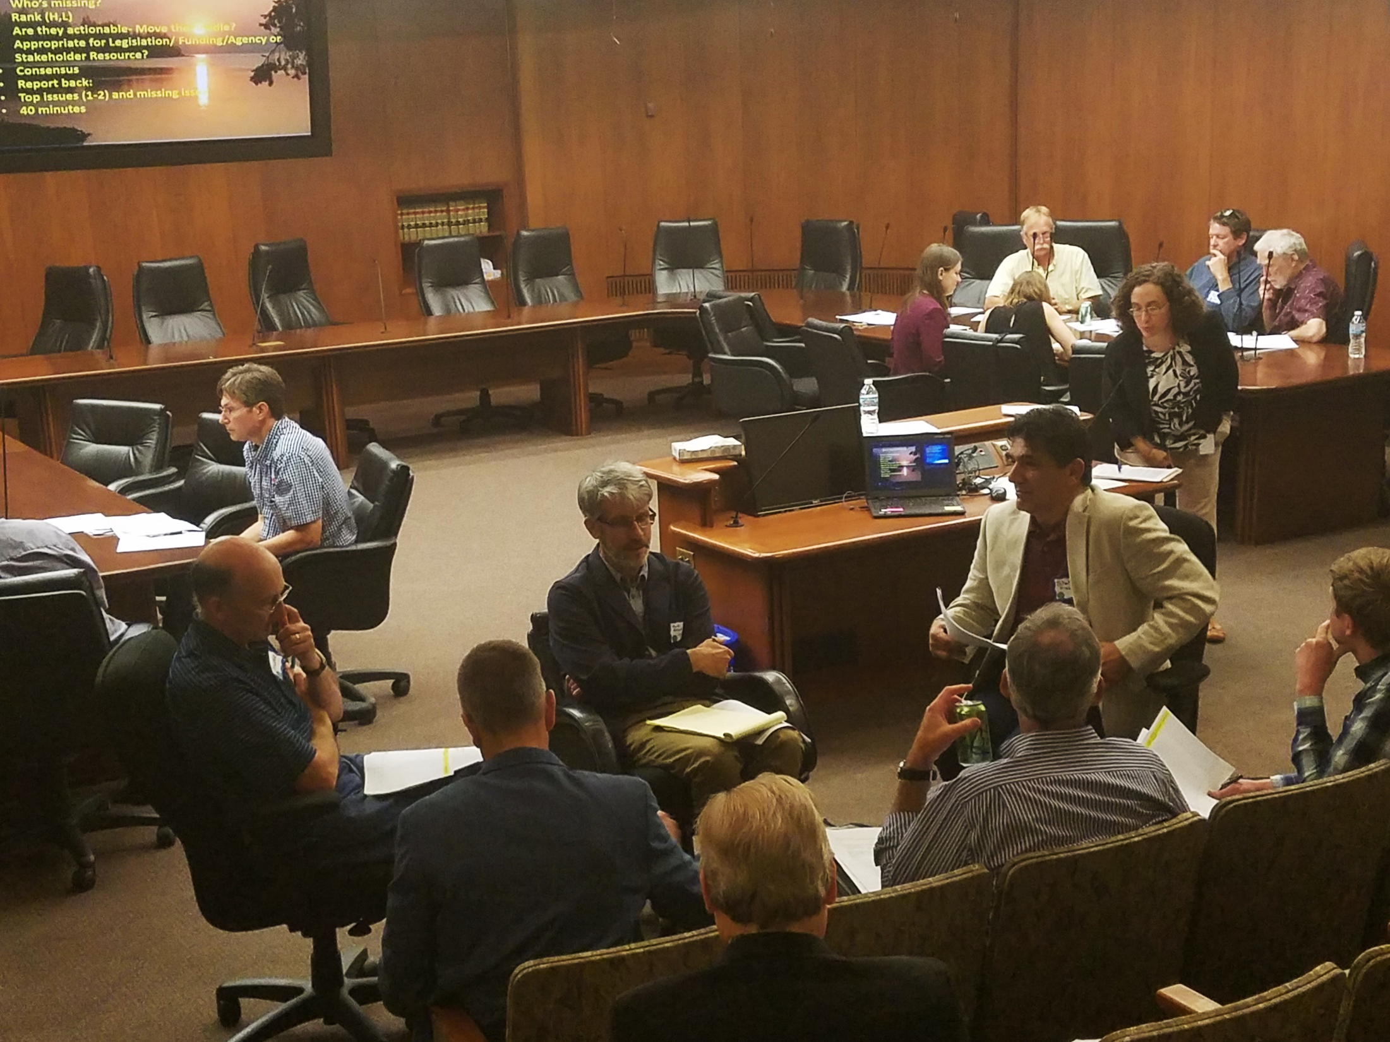
Step 2: Five Stakeholder meetings
Six Issues
About 100 recommendations

Slide 9
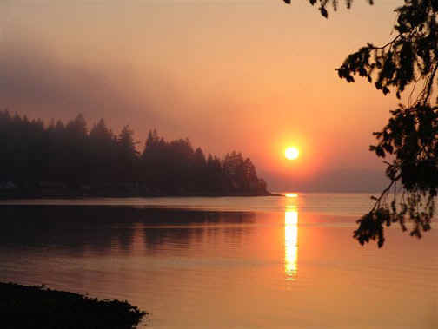

Thanks!
Step 3: Survey follow-up
188/450 responses
Notes:
For more information and real time monitoring data you can visit this web site.

Slide 10
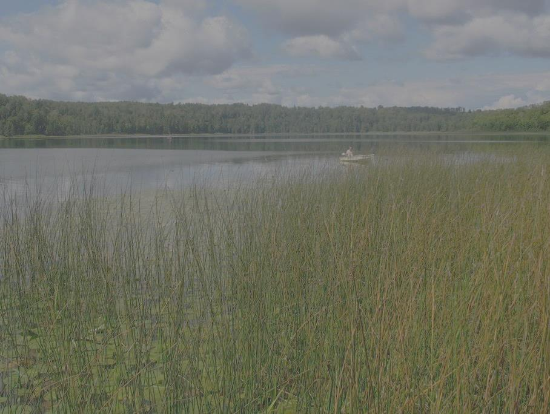
Step 4: Ranking Recommendations

Slide 11
12 Recommendations
  Inflow and Infiltration-- Wastewater
  Healthy Soil/ Healthy Water
  Water Infrastructure
  Peer review of wastewater standards
  Reducing excess Chloride
  Continuation of the LWC
  Keeping Water on the Land
  Data, information, Education and Public Awareness
  Preserving and protecting our lakes
  Expanded source water programs
  Increase drinking water protection Fee
  Statewide Water Policy
Notes:
For more information and real time monitoring data you can visit this web site.

Slide 12
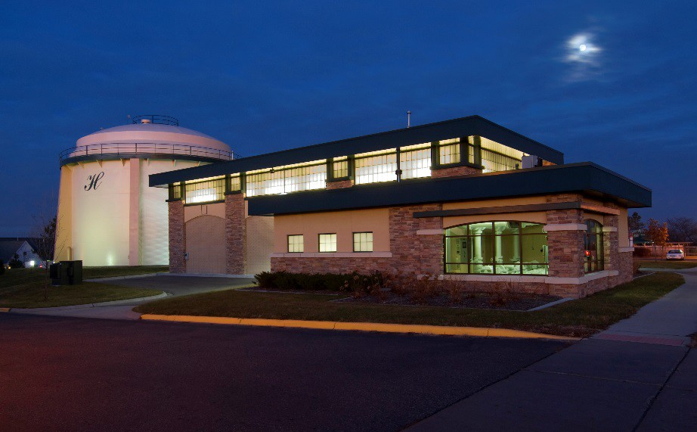
# 1) Wastewater: Inflow and Infiltration
  -Leakage into sewer lines is a
  Major problem
  -Increases treatment volumes
  -Reduces treatment efficiency
  Legislation to allow
  sanitary districts use of
  existing revenue to fix these
  problem– as cities can

Slide 13
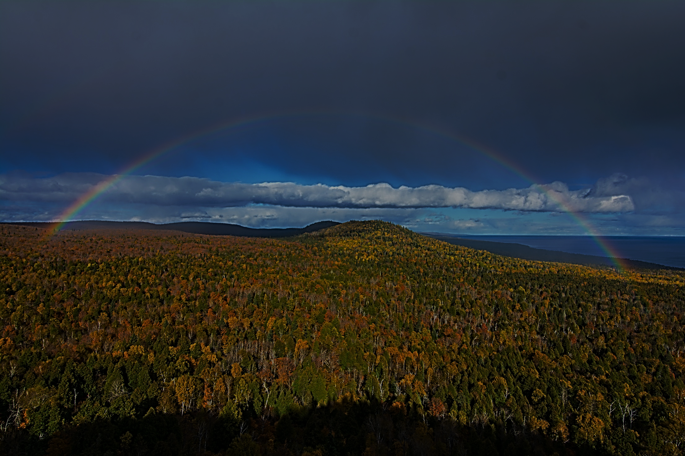
# 2) Healthy Soil/Healthy Water
  Healthy Soil=Productive Agriculture and Healthy Water
  Focus is on improving soil health and water retention and quality
  Provide support for UM, MDA, BWSR and CWC efforts for the long term (general fund)
  Initiate an interagency/UM statewide soil-health action plan
Notes:
to the northern forests

Slide 14
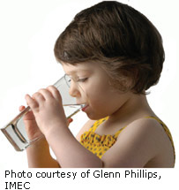
# 3) Improve Water Infrastructure
Water infrastructure is aging
Significant problem for small cities
Support long-term continuous GO bonding
New and increased support for cities: efficiencies, alternatives, technical assistance, asset management, regional cooperation, water-quality trading, incentives for failing septic systems
General Funds: coordinate with and increase ongoing programs and pilots: PFA, MPCA, MDH, PFA
Notes:
What we hope to leave you with is a much better understanding of our state’s groundwater resources and appreciation for the challenges we face.
Simply stated the problem we are increasingly recognizing is that there are ….

Slide 15
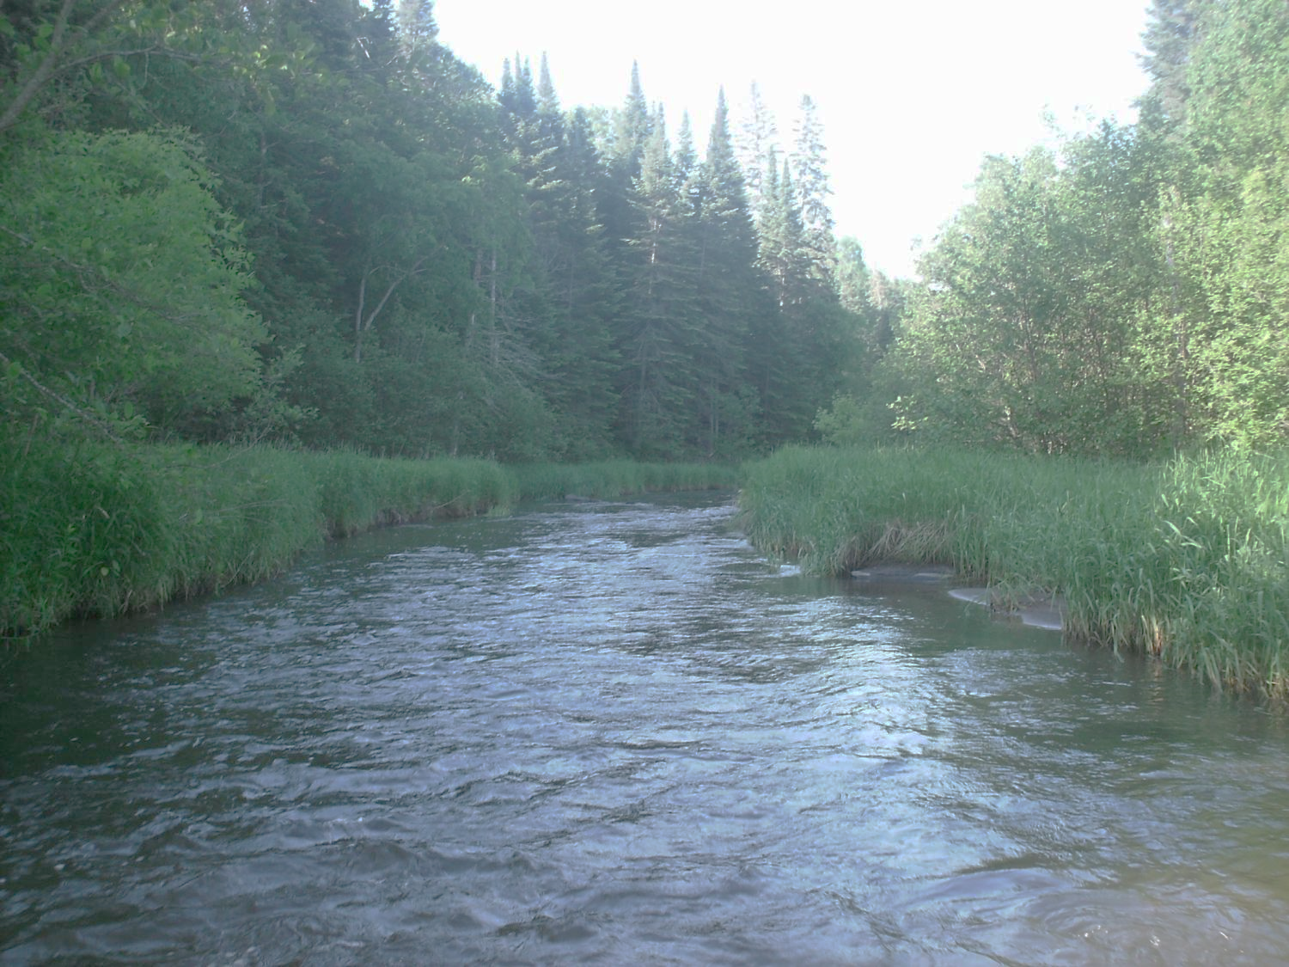
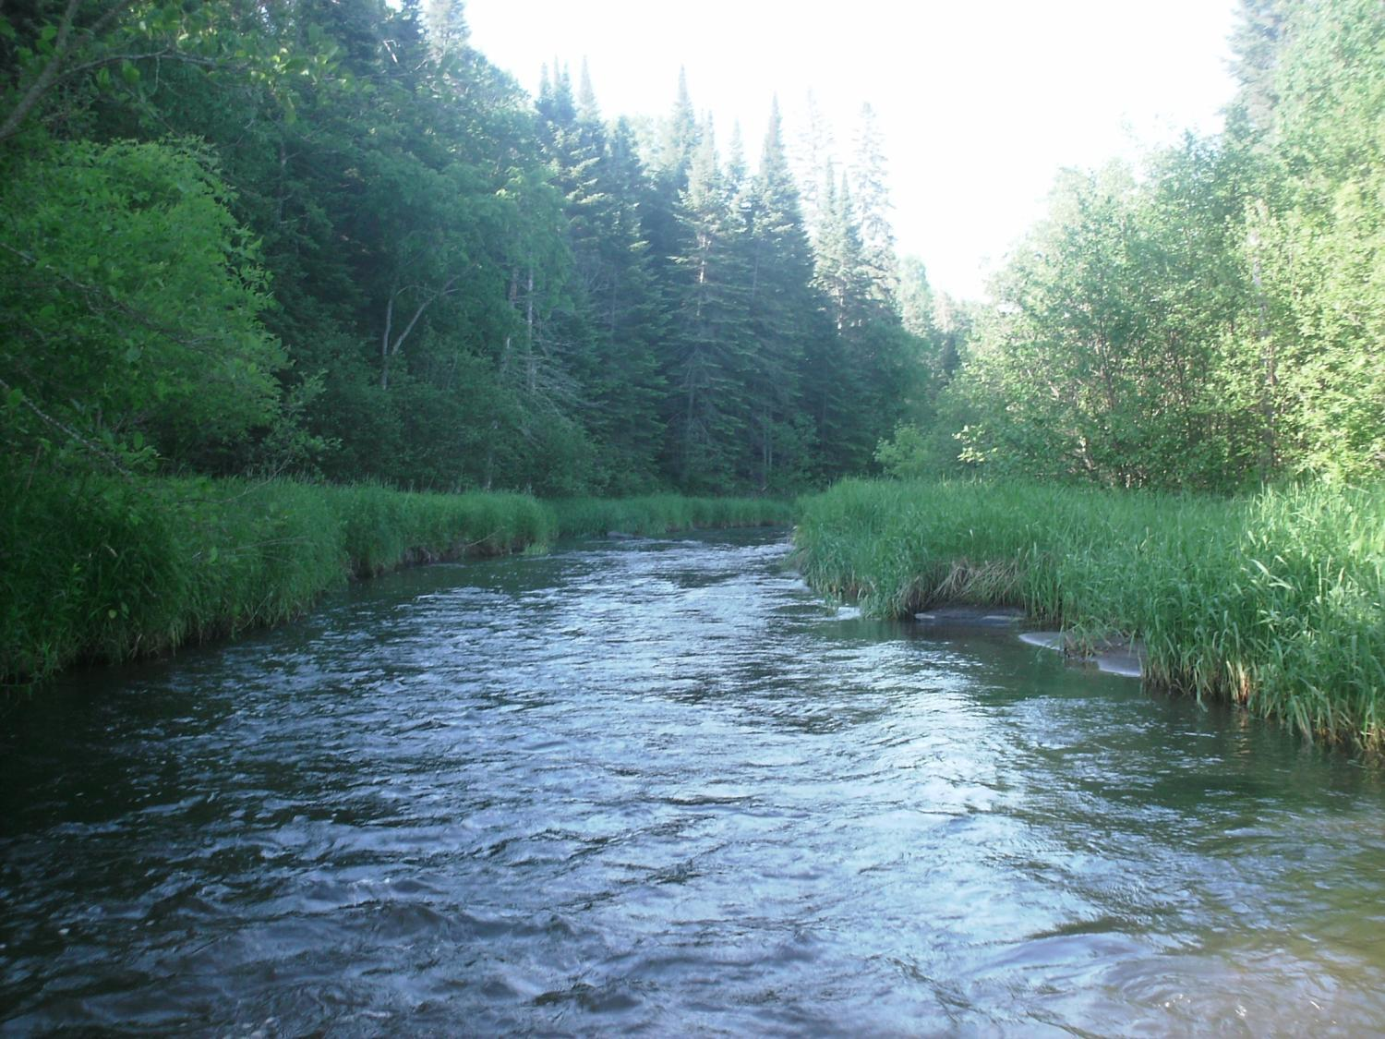
# 4) Peer Review of Wastewater Standards
Wastewater standards change and evolve over time
Presents a burden for small cities
Change typically follows a defined EPA process
However, state- mandated changes are not mandated by the EPA
State mandated changes use a similar MPCA Commissioner’s Order process
Legislation to memorialize order into statute
Peer Review of Wastewater Standards
15

Slide 16

# 5) Over-Use of Chloride Deicers
Chloride is over applied in some areas
Degrades streams and groundwater
Septic systems and water softening contribute to the problem
MDOT and cites have made good progress
Commercial applicators need assistance
General funds to continue applicator training
Extend training statewide (MPCA)
Legislation: limited liability for
qualified applicators
Assess other sources

Slide 17
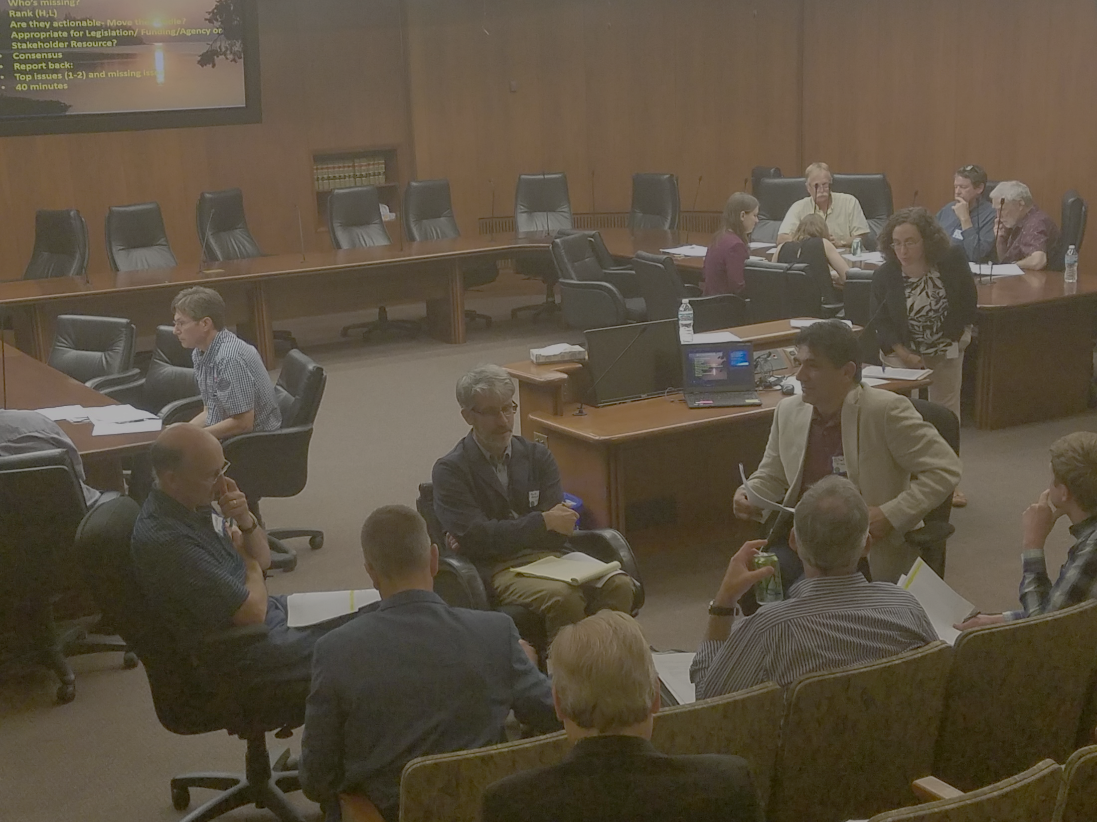
# 6) Continuation of the LWC
LWC:
Improved coordination with other Legislative Committees
Brings issues to the Legislature
Connect with stakeholders/citizen groups
Coordinate with CWC, LSOHC, LCCMR
Coordinate with Administration/Agencies
Coordinate legislation prior to sessions
Assess trends in water-related funding
Legislation: LWC sunsets- July 2019

Slide 18
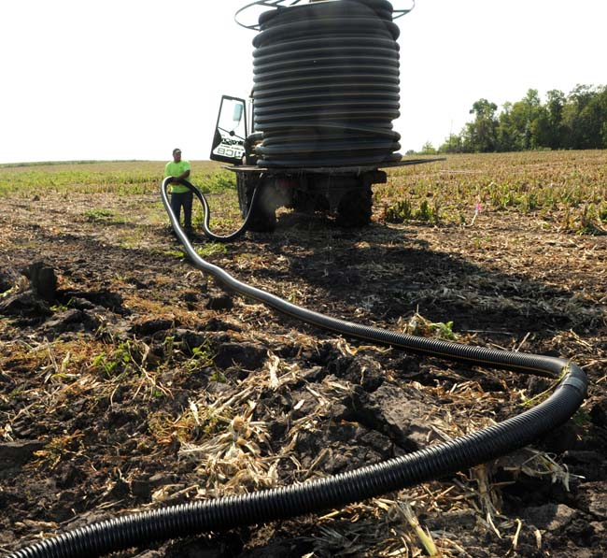
# 7--Keeping Water on the Land
  Most complex of the recommendations
  Water retention improves soil health, water quality and gw recharge
  Suggested needs:
  Support agency evaluations of most effective BMPs, at the best locations
  Increase general fund obligation for targeted/efficient/incentivized BMPS
  Determine extent and impact of tile drains
  Support ROI evaluations of BMPs
  Support consensus positions from the DWG
  Increase incorporation of BMPs in 1 watershed/1 plan
  Evaluate urban BMPS
  Revise HF3908 to include local water planning and implementation to include TMDLs, WRAPs, and 1W/1 Plan
  Expand pilot pollutant trading following LCCMR pilots
  Create trading credit- exchange vehicle
  Expand and fund expansion of agency programs
  Increase general funding
  Create interagency/watershed efforts to coordinated plans

Slide 19
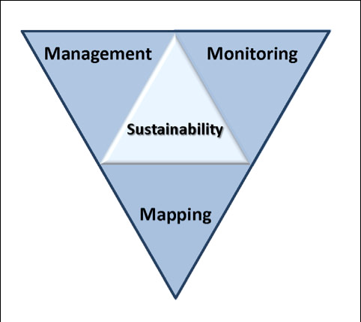
# 8: Ensuring Water Sustainability--Information, Education and Awareness
  Enhance continue County Atlas Programs
  Increase information about gw/sw interaction
  Improve understanding or water bank accounts
  Incorporate water balances analysis in Co Atlas and 1W/Plan processes
  Expand gw management area assessments
  Increase educational and outreach activities
  Legislative direction and funding for
  existing agency, MGS and watersheds
Notes:
Protection of ground water and surface water resources will require substantial investments from a diversity of funding sources over all levels of government during the next decade. As a part of this effort, this program of mapping, monitoring and managing is necessary to deliver the basic understanding of the hydrologic system for both surface and groundwater.

Slide 20
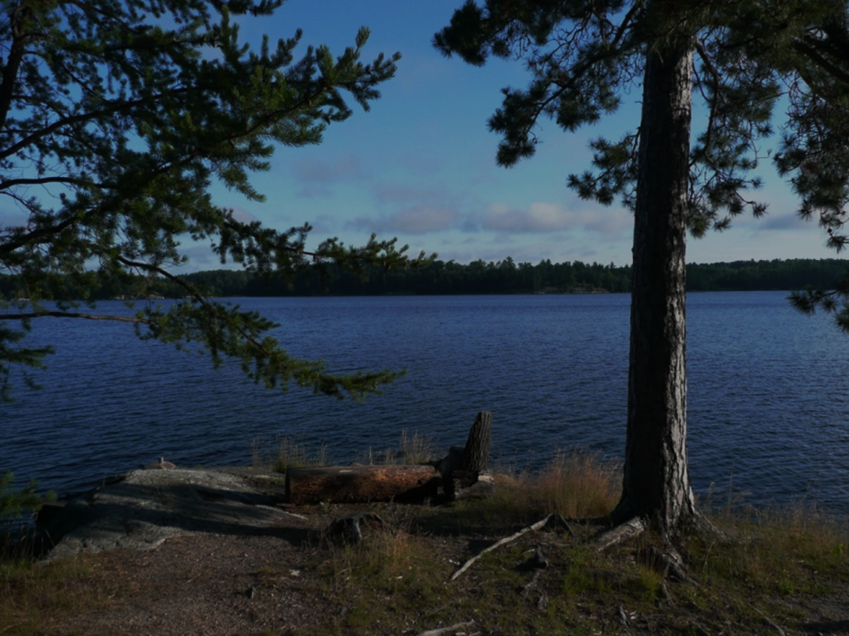
#9 Lakes—Preserve and Protect
  MN lakes are aging and threatened
  We can’t protect all of them
  Policy is needed
  Protect and preserve the most important: ex Cold water lakes
  Strategic data collection- Sentinel lakes
  Establish lake priorities
  Increase conservation easement for priority lakes
  Accelerate efforts to control invasive species
  Prepare management strategy for uncertain future
  Increase and coordinate agency programs
  Increase general fund support

Slide 21
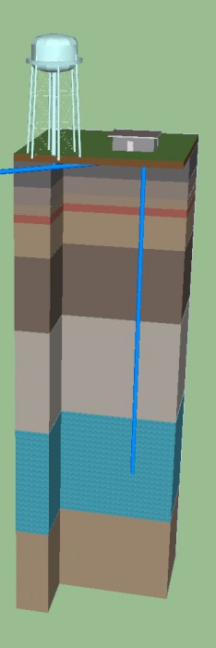
# 10: Expand Source Water Protection (MDH)
  Expand programs to rivers
  Include aquifers– private wells
  Identify most vulnerable aquifers
  Increase real-time monitoring for rivers Improve public information and outreach
  Support CWC’s efforts to increase vegetative cover
  Encourage new markets
  Increase general fund obligations (MDH)
  Increase and coordinate agency programs
  Coordinate with CWC/ LCCMR

Slide 22
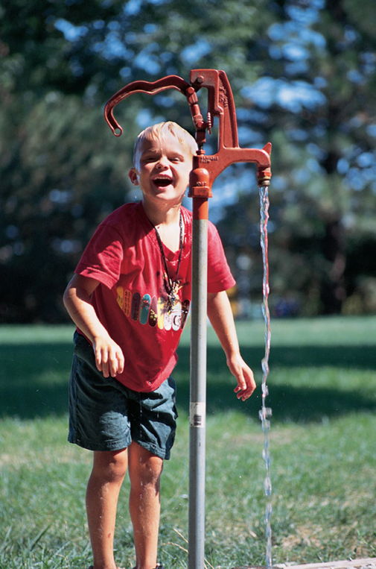
# 11—Increase Water Service Connection Fee
  Fee structure has been static
  Program costs have increased
  Increasing needs for condition assessments (Lead for example)
  Growing need for asset management plans
  Legislation needed to increase fees

Slide 23
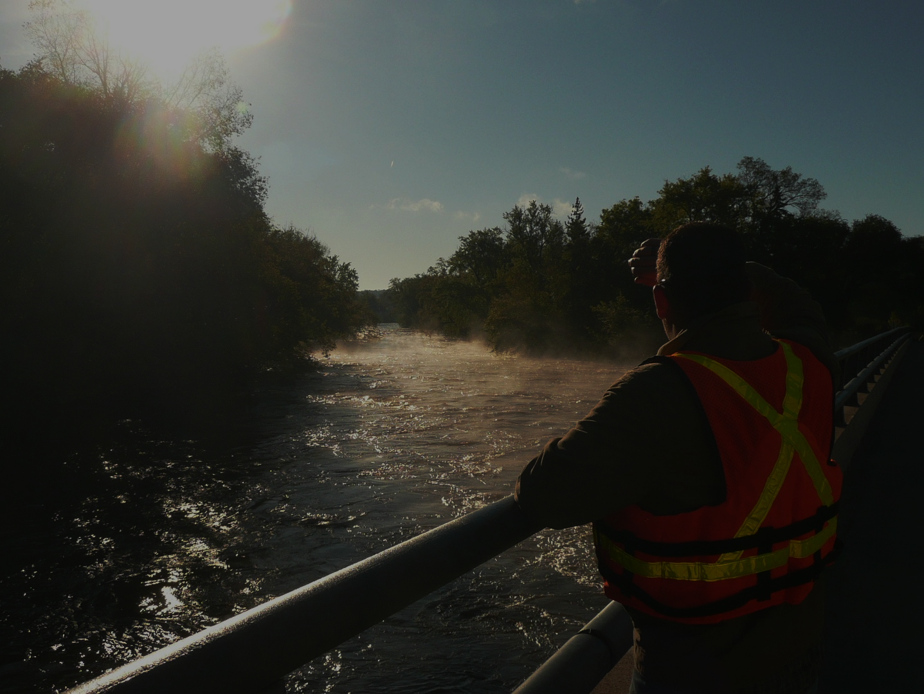
# 12 Statewide Water Policy
  As a state, we need to plan for an uncertain future
  Provide adaptation plans for changes– long term roadmap
  Incorporate the other recommendations- Involve stakeholders
  Address emerging issues
  Balance water resource needs with economic health
  Consider:
    Climate and weather changes
    Infrastructure resiliency
    Lake preservation
    Water sustainability
    Water quality
    Mineral extraction
    Population change
    Land use Change and use change
  Provide general funds and guidance for an interagency/legislative roadmap for future legislation and policy
23

Slide 24
  Member Consensus
24

Slide 25
Next Steps
  Revise Issue Statements
  Revise Recommendations
  Initial Consensus from LWC
  Feedback from Stakeholders
  Consolidate recommendations into recommendation themes
  LWC Consensus
  Recommendations to Legislature
  Legislative briefings with Environmental Committees/Agency staff

Slide 26
Thank You!
Notes:
For more information and real time monitoring data you can visit this web site.

