Slide 1
Legislative-Citizen Commission on Minnesota Resources July 18, 2018
James Nobles | Legislative Auditor
Christopher Buse | Deputy Legislative Auditor
Tracy Gebhard | Audit Director

Slide 2
Today’s Agenda
Office of the Legislative Auditor overview
Legacy Amendment work done by OLA
Board of Water and Soil Resources report
Council member questions and concerns

Slide 3
Office of the Legislative Auditor
OLA is a professional, nonpartisan office within the legislative branch of Minnesota state government
Our mission is to support legislative oversight and strengthen accountability in state government
We provide assurance that questions and concerns about government operations and the use of public resources will be addressed thoroughly and objectively

Slide 4
Organization
Legislative Auditor
Program Evaluation Division
Financial Audit Division
Special Reviews

Slide 5
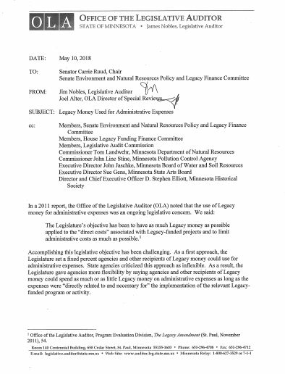
Legacy Amendment Work
Program Evaluations
Financial Audits
Special Reviews

Slide 6
Focus Areas
Use of Legacy funds for purposes consistent with law
Oversight of legacy-funded projects
Controls over administrative expenses
Achievement of program outcomes

Slide 7
Board of Water and Soil Resources

Slide 8
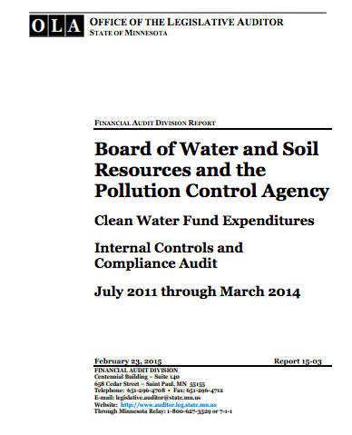
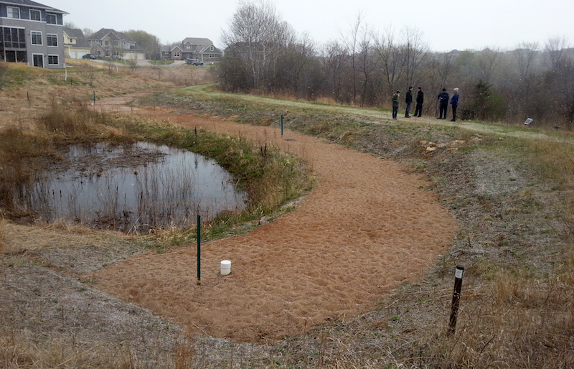
Why Audit?
Environment
Legislative Interest in Environmental Issues is High
Complexity
Funding Sources Have Complex Legal Compliance Requirements
Cost
The Agency Spends About $100 Million Annually
Risk
History of Audits with Significant Findings

Slide 9
Areas Examined
Area | Description
Grants | Environmental grants, primarily to local governments, account for 49% of expenditures
Easements | Easement to landowners account for about 34% of expenditures
Payroll | Employee costs account for about 10% of expenditures
Administrative | Travel, supplies, and other costs necessary to operate the agency account for about 7% of expenditures

Slide 10
Conclusion
Internal Control
Legal Compliance
Inadequate
Adequate
Noncompliant
Compliant
Findings
No issues with grant and easement expenditures
Significant internal control and compliance issues with payroll and other administrative expenditures

Slide 11
Finding 1
The board did not establish appropriate fiscal oversight controls for administrative expenditures
Numerous internal control and compliance issues
Repeat findings
History of shortcomings merits a deeper assessment of staff and accounting practices
Recommendation
OLA recommends seeking external help to rectify longstanding fiscal oversight weaknesses

Slide 12
Finding 2
The board did not consistently resolve conflicts of interest
Audit identified 8 instances where reported conflicts were not managed in accordance with state policies
State policies require that potential conflict be disclosed to all parties in the grant process
Resolutions to potential conflicts must be noted in meeting minutes
Recommendation
OLA recommends actively managing potential conflicts of interest in accordance with state law and policy

Slide 13
BWSR Disagrees
Disclose
Discuss
Document
Proactive process to identify conflicts
No issues
Open discussion between all grant process participants
No evidence to show that all potential conflicts were openly discussed with all members
Resolution of conflicts fully documented in board minutes
No documentation to support why some members with conflicts were allowed to vote
Criteria
Issue

Slide 14
Finding 3
The board did not have appropriate controls to ensure compliance with funding use legal restrictions
Many instances of noncompliance
Lack of records made it very difficult to conduct the audit
Recommendations
OLA recommends implementing controls to ensure compliance with funding source legal provisions
OLA recommends correcting the errors found during the audit

Slide 15
Finding 4
The board did not follow state accounting policies
Transaction coding
Payroll, personnel, and expense reimbursement processing
Management of access to statewide systems
Recommendations
OLA recommends following state payroll, personnel, accounting, and system access policies
OLA recommends correcting the errors found during the audit

Slide 16
Questions?
James.Nobles@state.mn.us
Chris.Buse@state.mn.us

