Slide 1
MPCA’s priority Closed Landfills: WDE Landfill (Andover) and Freeway Landfill (Burnsville)
July 18, 2018

Slide 2
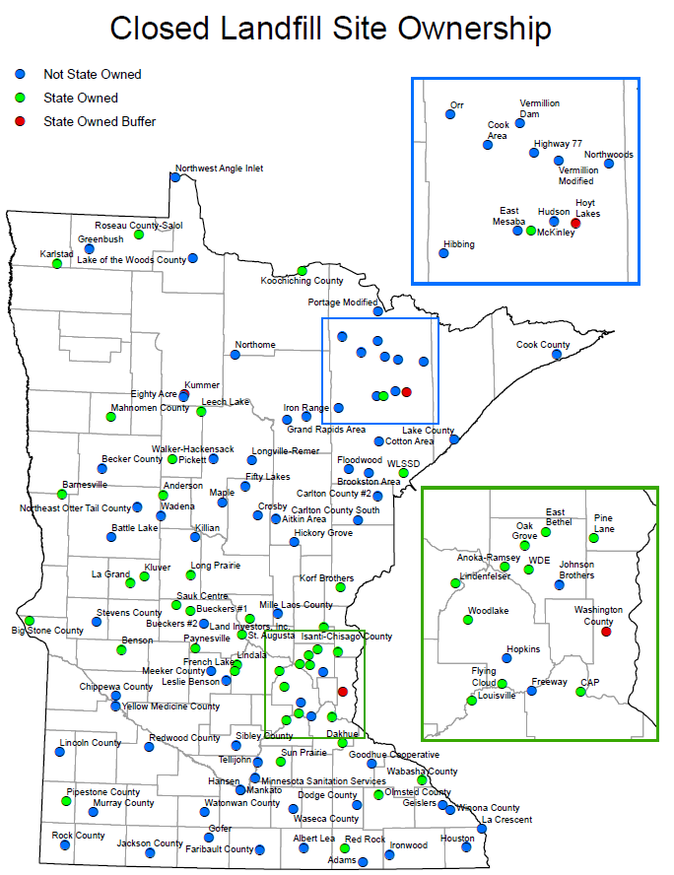
Closed Landfill Program
The Legislature created the Closed Landfill Program in 1994.
MPCA is responsible for managing closed landfills that were permitted to hold mixed municipal solid waste that are enrolled in the program.
Goal: Mitigate risks to the public and the environment.
Today: 109 closed landfills statewide (114 eligible)
Notes:
Please see handout titled “Closed Landfill Site Ownership”
We manage each of these 109 landiflls by:
monitoring environmental impacts and site conditions at each landfill
determining the risk each landfill poses to public health, safety and the environment
implementing cleanups and maintaining landfill covers, caps and property
working with local governments to incorporate land-use controls at and near the landfills to protect human health and safety,
measuring how well the CLP is managing the risk at the landfills
The MPCA is responsible for these Closed Landfills in perpetuity.

Slide 3
Closed Landfill Program Priorities
Closed landfills are scored based on:
presence and degree of hazards at each site - groundwater, surface water, and methane gas
conditions that exacerbate those hazards (fractured bedrock, drinking water impact)
the likelihood the public will be exposed to those hazards (distance to wells, homes)
other risk factors (volume of waste, history of trespass, etc.)
Numerical values are assigned to each of these risks and are totaled to calculate a site’s risk priority score.
This ranking process is completed annually.
Notes:
Landfills are scored based on:
presence and degree of groundwater, surface water, and methane gas hazards at each site (based on monitoring data and field observations)
conditions that exacerbate those hazards (ex: fractured bedrock, aquifer used for drinking water, ability for methane to migrate)
the likelihood the public will be exposed to those hazards (number of and distance to wells and buildings)
other risk factors (ex. volume of waste, history of trespass, control of land uses)
Numerical values are assigned to each of these risks and are totaled to calculate a site’s risk priority score – landfills with high risk scores receive a high ranking or priority. (done annually)
In January 2017, risk scores ranged from 1 (lowest risk) to 50,605 (highest risk).

Slide 4
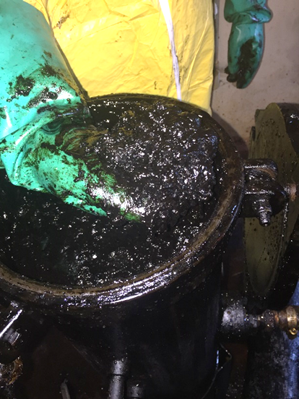
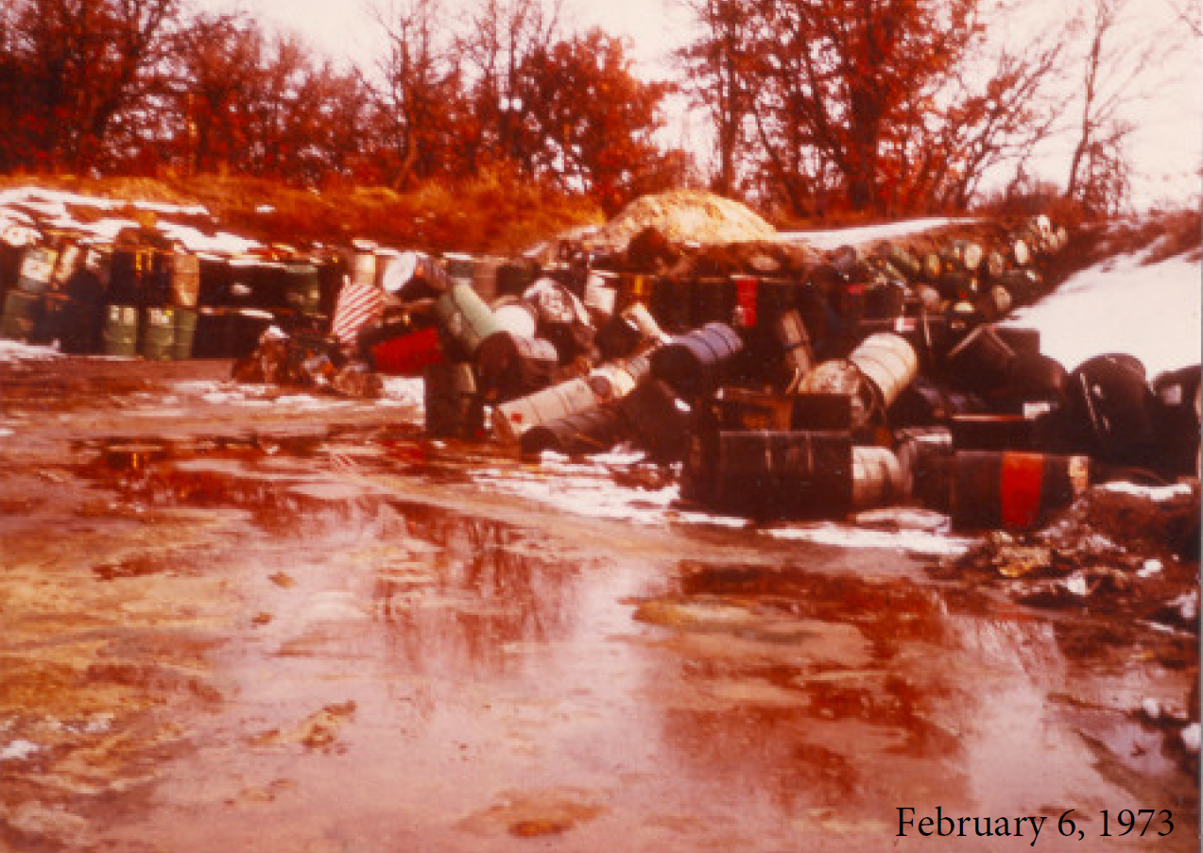
Waste Disposal Engineering (WDE) Landfill in Andover

Slide 5
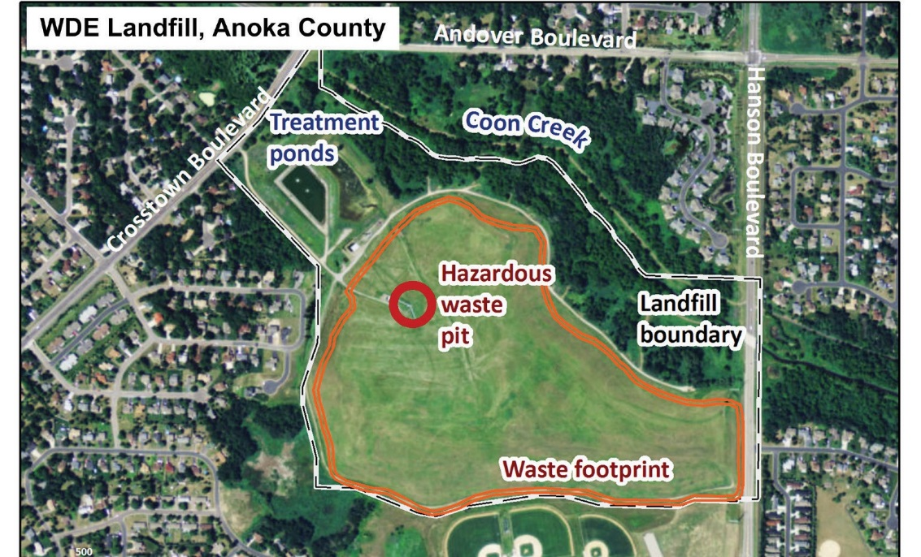
The WDE Landfill site in Andover
1/3 acre hazardous waste pit within 122 acre landfill
6,600 barrels buried in pit between 1972-74
PCBs, paint wastes, heavy metals, solvents, VOCs
4 mitigation systems at landfill – plus barrier wall around pit
FY 2016: $650,000 from General Fund for design/engineering
FY 2017: $11.35 M in bonding for cleanup and construction

Slide 6
WDE Landfill - Extensive contamination discovered
Cross-cut view of hazardous waste pit
September 2017
Existing hazardous waste liner is completely dissolved, not just degraded
20 feet of soil under the pit is saturated with hazardous waste
Underlying aquifer is contaminated

Slide 7
2018 Bonding: $6 M for WDE Landfill
An additional $6M is needed to finish the cleanup at WDE.
Additional sampling is underway
Community meeting in Fall 2017
Neighbors have high interest in cleanup plans
City, county, MPCA, residents maintain 2-way communications
Projected cleanup: Winter 2018-19
Notes:
WDE Landfill history.
1960s – township dump
1971 –The state permitted the Waste Disposal Engineering WDE Landfill (LF) in Andover, including an asphalt lined hazardous waste pit.
1972-74 - Records indicate the pit was used for disposal of more than 6,000 barrels of hazardous wastes.
The state has since determined the HW pit is leaking and causing significant groundwater (GW) contamination and presenting other safety concerns.
In FY14 the CLP spent more than $735,000 to treat contamination from the HW pit, GW and LF and address other post-closure care responsibilities.
Residential development is 200 feet from the LF and while those residences are on municipal water supplies there is still concern relative to gas and vapor migration into homes.
This is the number 1 priority risk site out of 112 landfills currently qualified for the CLP.
The CLP is proposing to remove and properly dispose of the contents of the HW as well as associated contaminated soils underlying the pit.
There is a high likelihood that site treatment costs will be reduced by more than $450,000 annually if the HW pit is removed. An ongoing concern is the annual cost of treatment systems at the site.
The hazardous waste pit is a significant source of groundwater contamination at the landfill.
Residential drinking water wells are present near the site – although not impacted currently – but are a potential receptor
Operating the existing treatment systems is estimated to cost more than $600K/year
Excavation of the buried drums and waste will remove a significant source and save long-term O&M costs
Four treatment systems:
PCB Treatment
Vapor treatment
Gas (methane) treatment
Groundwater treatment

Slide 8
Freeway Landfill & Dump in Burnsville

Slide 9
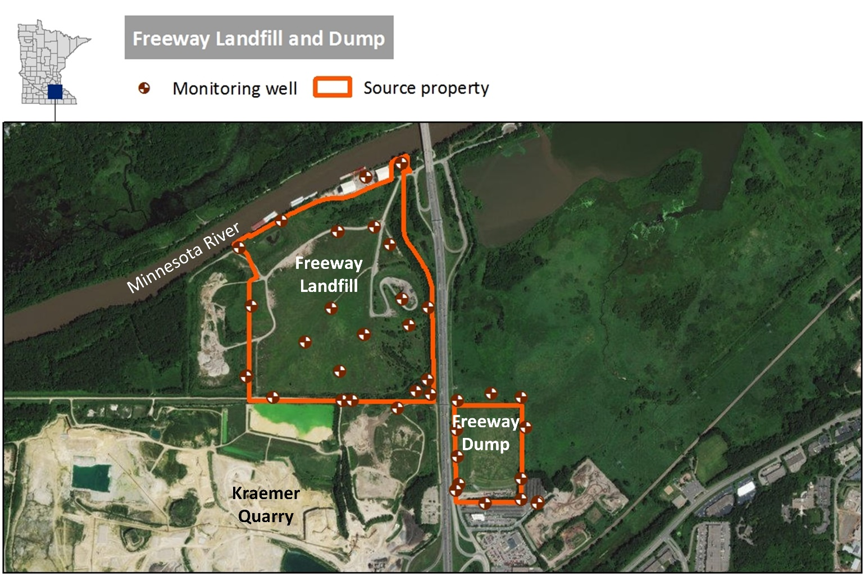
Freeway Landfill & Dump in Burnsville
Freeway Dump
Operated 1961-71
28 acres
600,000 – 1 million cubic yards
Freeway Landfill
Operated 1969-90
150 acres
5 million cubic yards
Both are unlined
Located above drinking water source for Burnsville and Savage
Built on former wetland south of and adjacent to Minnesota River

Slide 10
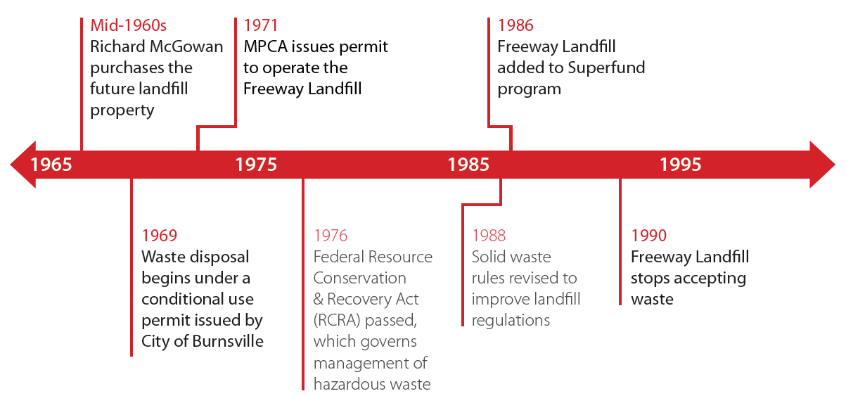
History of Freeway Landfill

Slide 11
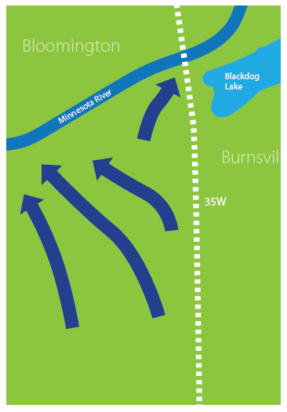
Groundwater flow: historical
Before the landfill existed, this site was a wetland.
Groundwater flowed mainly to the Minnesota River.
Today’s regulations would never allow a landfill to be placed on such a site.

Slide 12
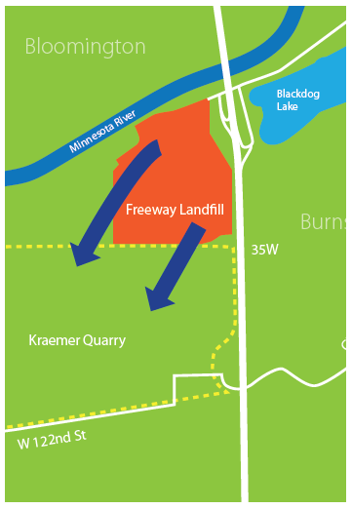
Groundwater flow today
Kraemer Quarry pumps 10 million gallons of groundwater per day away from the landfill and the river.
This lowers the water table, preventing the waste in Freeway Landfill from sitting directly in groundwater.

Slide 13
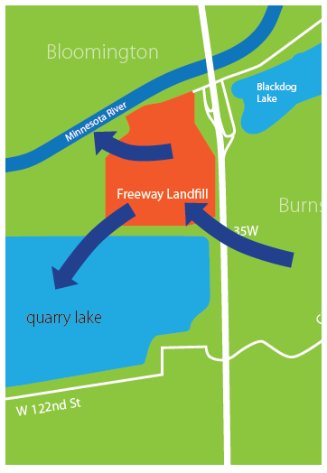
Groundwater flow in the future
When Kraemer Quarry stops pumping, groundwater will again flow toward the Minnesota River, through Freeway Landfill.
The Quarry will fill with water and become a lake.
Both the river and the lake will be at risk for contamination from the landfill.

Slide 14
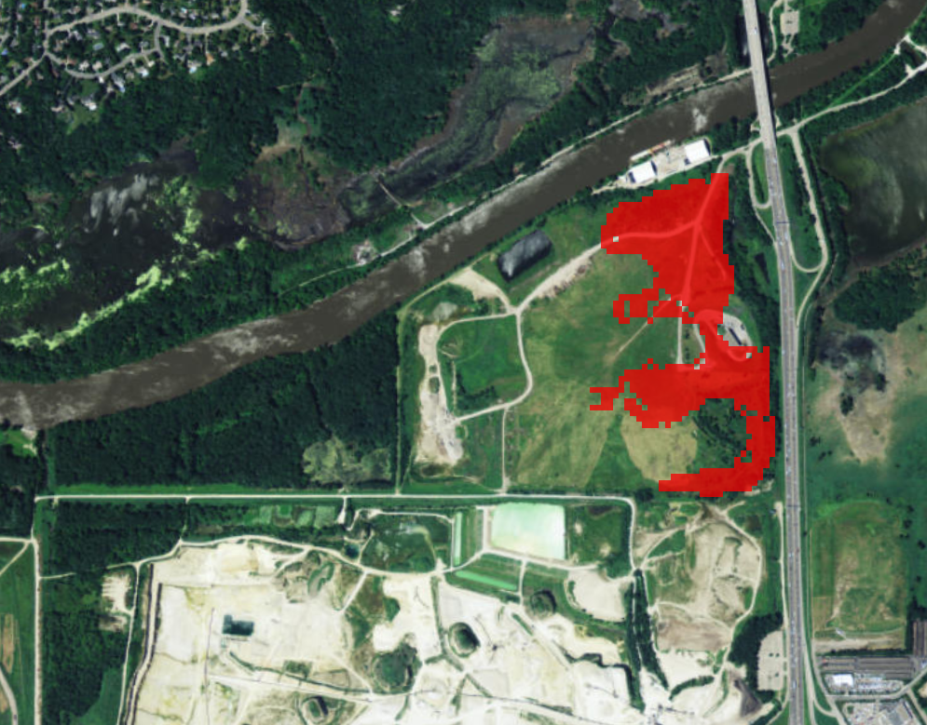
Freeway Landfill: a looming threat to groundwater
The groundwater level will also rise in the months after Kraemer Quarry stops pumping.
When this happens, the waste and leachate at the bottom of the landfill will be in direct contact with groundwater.
Under current estimates, cleaning Freeway Landfill and Freeway Dump will take about five years.

Slide 15
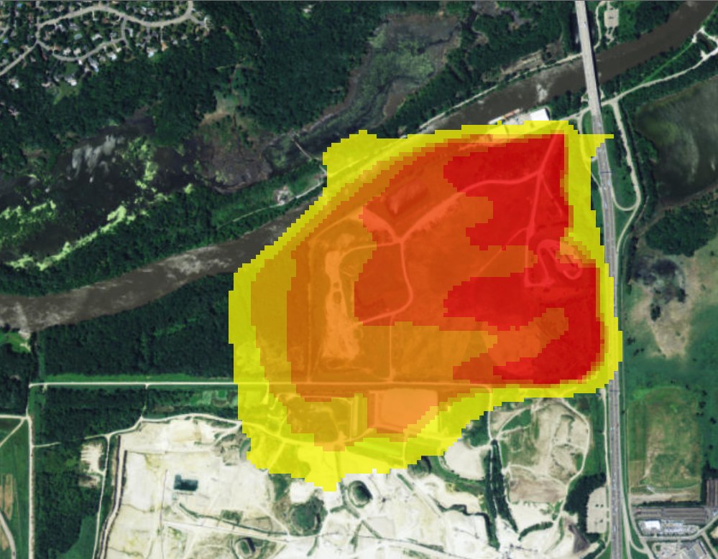
Freeway Landfill: a looming threat to groundwater
Over time, this contamination will reach both the Minnesota River and the Quarry Lake.

Slide 16
Preliminary results of 2018 investigation
Outer boundaries of waste still under investigation
Methane detected above the lower explosive limit
Contamination in groundwater above health standards for:
1,4-Dioxane
PFCs (PFOS, PFOA)
VOCs (BTEX, TCE)
Metals
Contamination in on-site surface water above criteria:
VOCs (BTEX, Vinyl Chloride)
Metals

Slide 17
Recent Legislation on Freeway Landfill
2017 Legislation:
Expanded closed landfill program authority to initiate cleanup activities & provide third party protections when there is a non-voluntary party
Directed MPCA to obtain lead agency role from US EPA
Added Freeway Dump
Appropriated $3 M from Closed Landfill Investment Fund for site evaluation and design.
In 2018 Session:
Governor’s Bonding Request included $ 52.763 M for 2 years’ worth of cleanup activities at Freeway Landfill,
$0 bonding was appropriated and Freeway Landfill was NOT included in either House or Senate Bonding bills,
Legislature directed LCCMR to consider funding cleanup at Freeway Landfill.

Slide 18
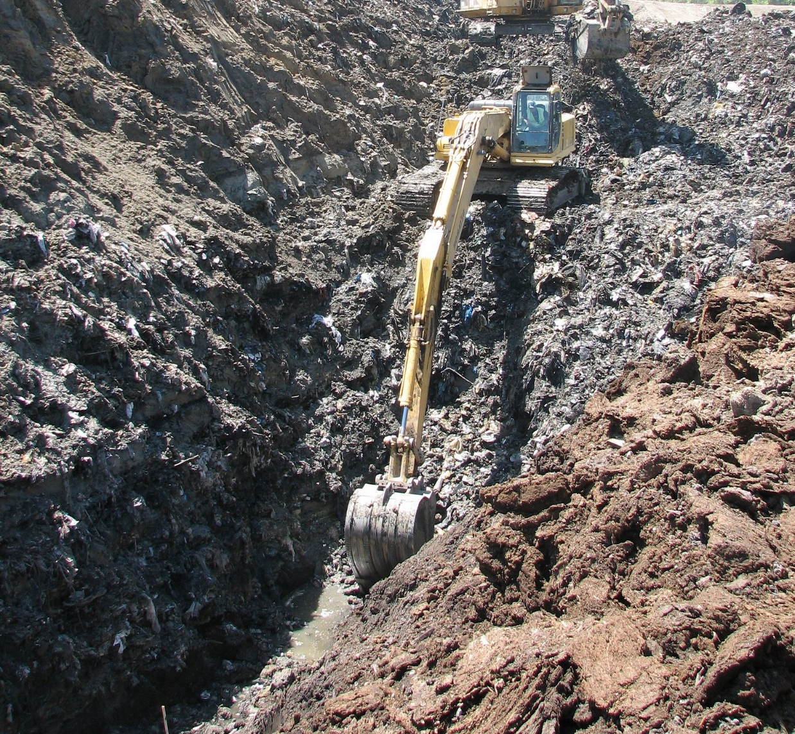
Three approaches to handling pollution
Prevent it
Manage it
Clean it up
Notes:
We address our mission from three different perspectives:
Pollution prevention means eliminating waste and pollution at its source. For example, our small business environmental assistance program helps companies reduce costs and increase efficiency. Another example is training road salt applicators to help prevent chloride pollution.
Managing pollution is the bulk of our work – which we accomplish through our water and air permits and the traditional regulation framework. But we also help manage pollution through efforts such as:
Capital Assistance Program projects and grants to local government for setting up infrastructure for recycling and waste reduction
Training for wastewater treatment plant operators to ensure proper management of municipal wastewater.
Cleaning up Past Pollution is key to protecting and enhancing human health. We do this in may ways, most visibly:
Closed Landfill Program
Superfund Program
And last session’s St. Louis River Area of Concern – Great Lakes Restoration Program

